Slide 1
Pharmacy medicine supply Management System

Slide 2
MFPE
POD DETAILS
Cohort Code:-INTCDE21IJ042
POD No:-4
TEAM DETAILS
Aniket Sriwastva(922357) Coach: Keerthana Ganesh
Gaurav Kumar Singh(922245) Trainer:Nilay Das
Rohit Garg(922348) Mentor: Renga Prasad
Pranav Dev Singh(922563)

Slide 3
Introduction
OnePharma is India’s leading consumer health platform. The main objective of this project is for a pharmaceutical company to automate the logic of forming a schedule for their medical representatives to meet the targeted doctors to explain their medicines and its nature for prescription. Based on the response from doctors, the medicine demand will be determined. This should be fed into the system to determine the medicine supply detail to its Pharmacists. The application developed will target this requirement

Slide 4
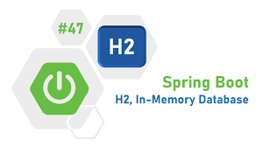





TECHNOLOGIES

Slide 5
Modules of Project
Medicine stock module
This module is a Middleware Microservice that performs the following operations:
Provides information on the pharma company medicine stock by the godown area
2. Medical representative schedule module
This module is a Middleware Microservice that performs following operations:
Creates a schedule to have meetings with doctors.
The list of doctors that this pharma company is targeting can be stored as a pre-defined information in this Microservice.
This module should interact with the medicine stock module to find the medicine stock to be explained to the targeted doctors

Slide 6
3. Pharmacy Supply module
This module is a Middleware Microservice that performs the following operations:
Gets the medicine count as demand as input from web portal.
Interacts with the Medicine supply microservice to find the final demand of medicine that can be supplied to its pharmacists
4. Authorization service
This microservice is used with anonymous access to Generate JWT
5. Pharmacy medicine supply portal
A Web Portal that allows a member to Login and allows to do following operations:
Login
View a schedule for medical representative for doctors meet
Provide in the data from medical reps with the medicine demand. Based on this input, the PharmacySupply microservice should provide the medicine count to be distributed to its pharmacists. This detail should be displayed on the UI.
Medicine demand and supply to pharmacists should be saved in the database.

Slide 7
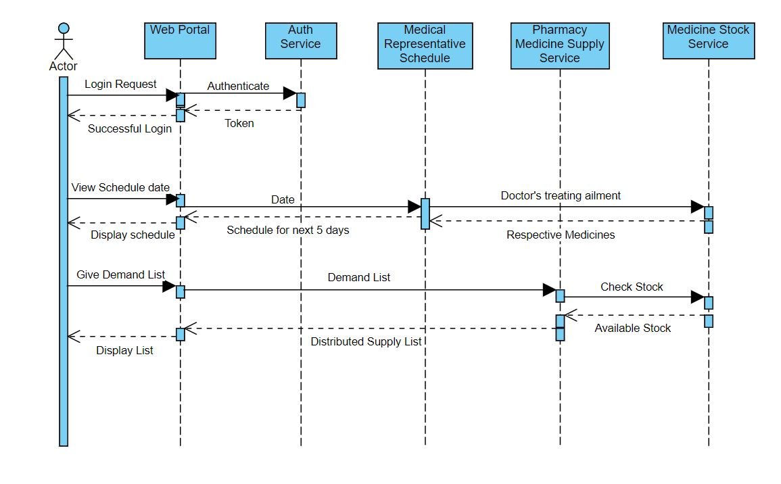
Sequence Diagram

Slide 8
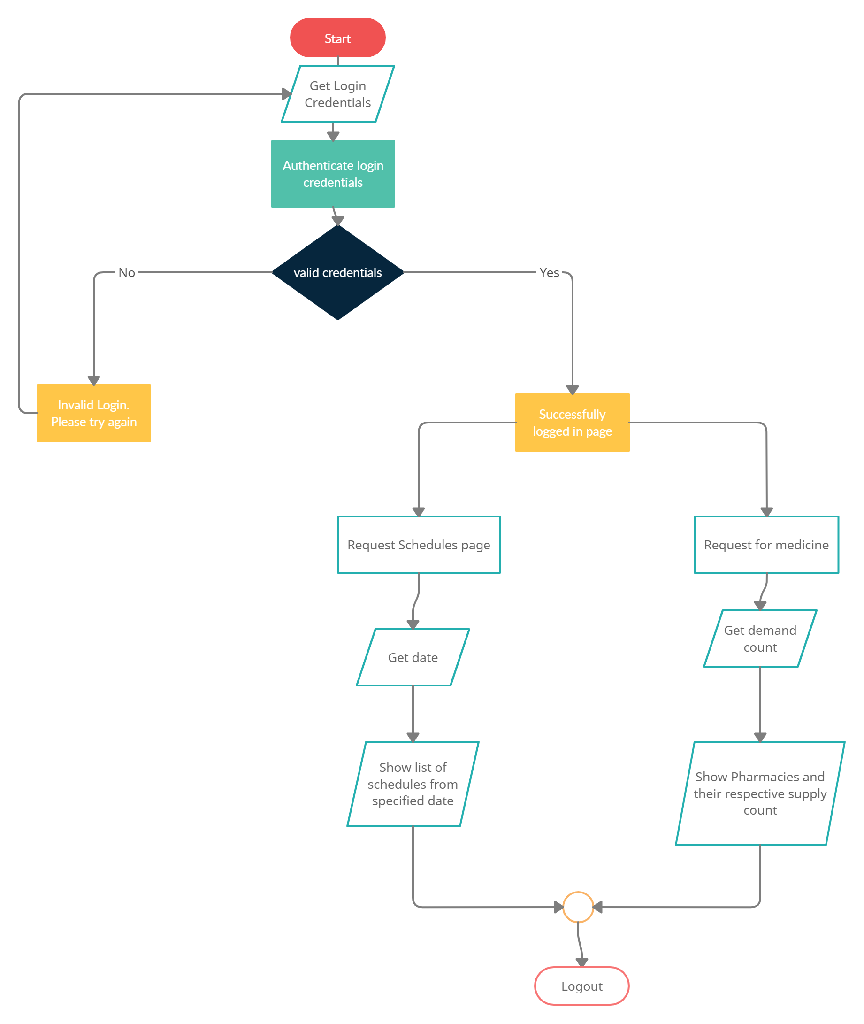
Workflow Diagram

Slide 9

Project Flow

Slide 10
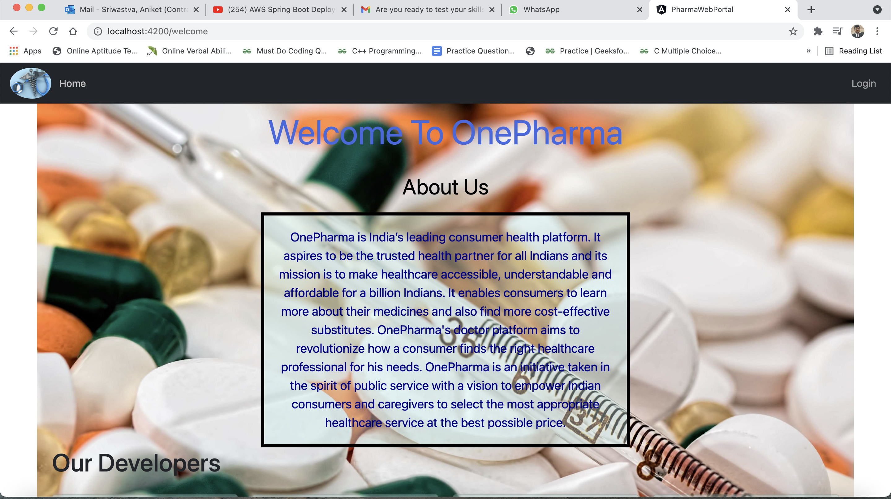
Homepage

Slide 11
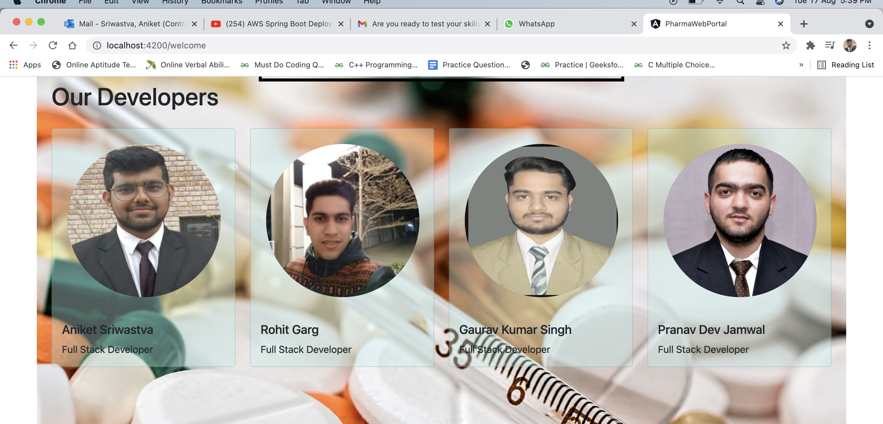

Slide 12
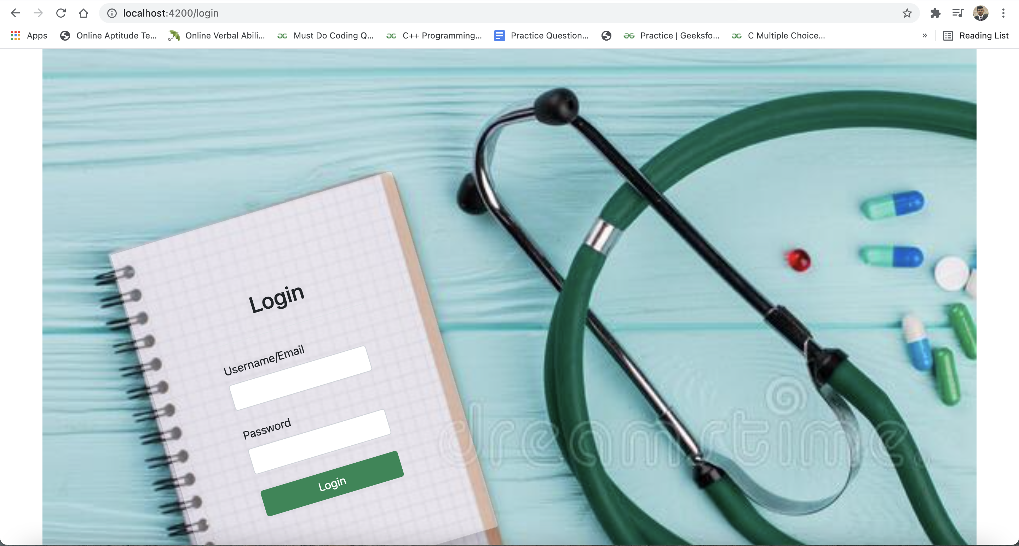
Login Page

Slide 13
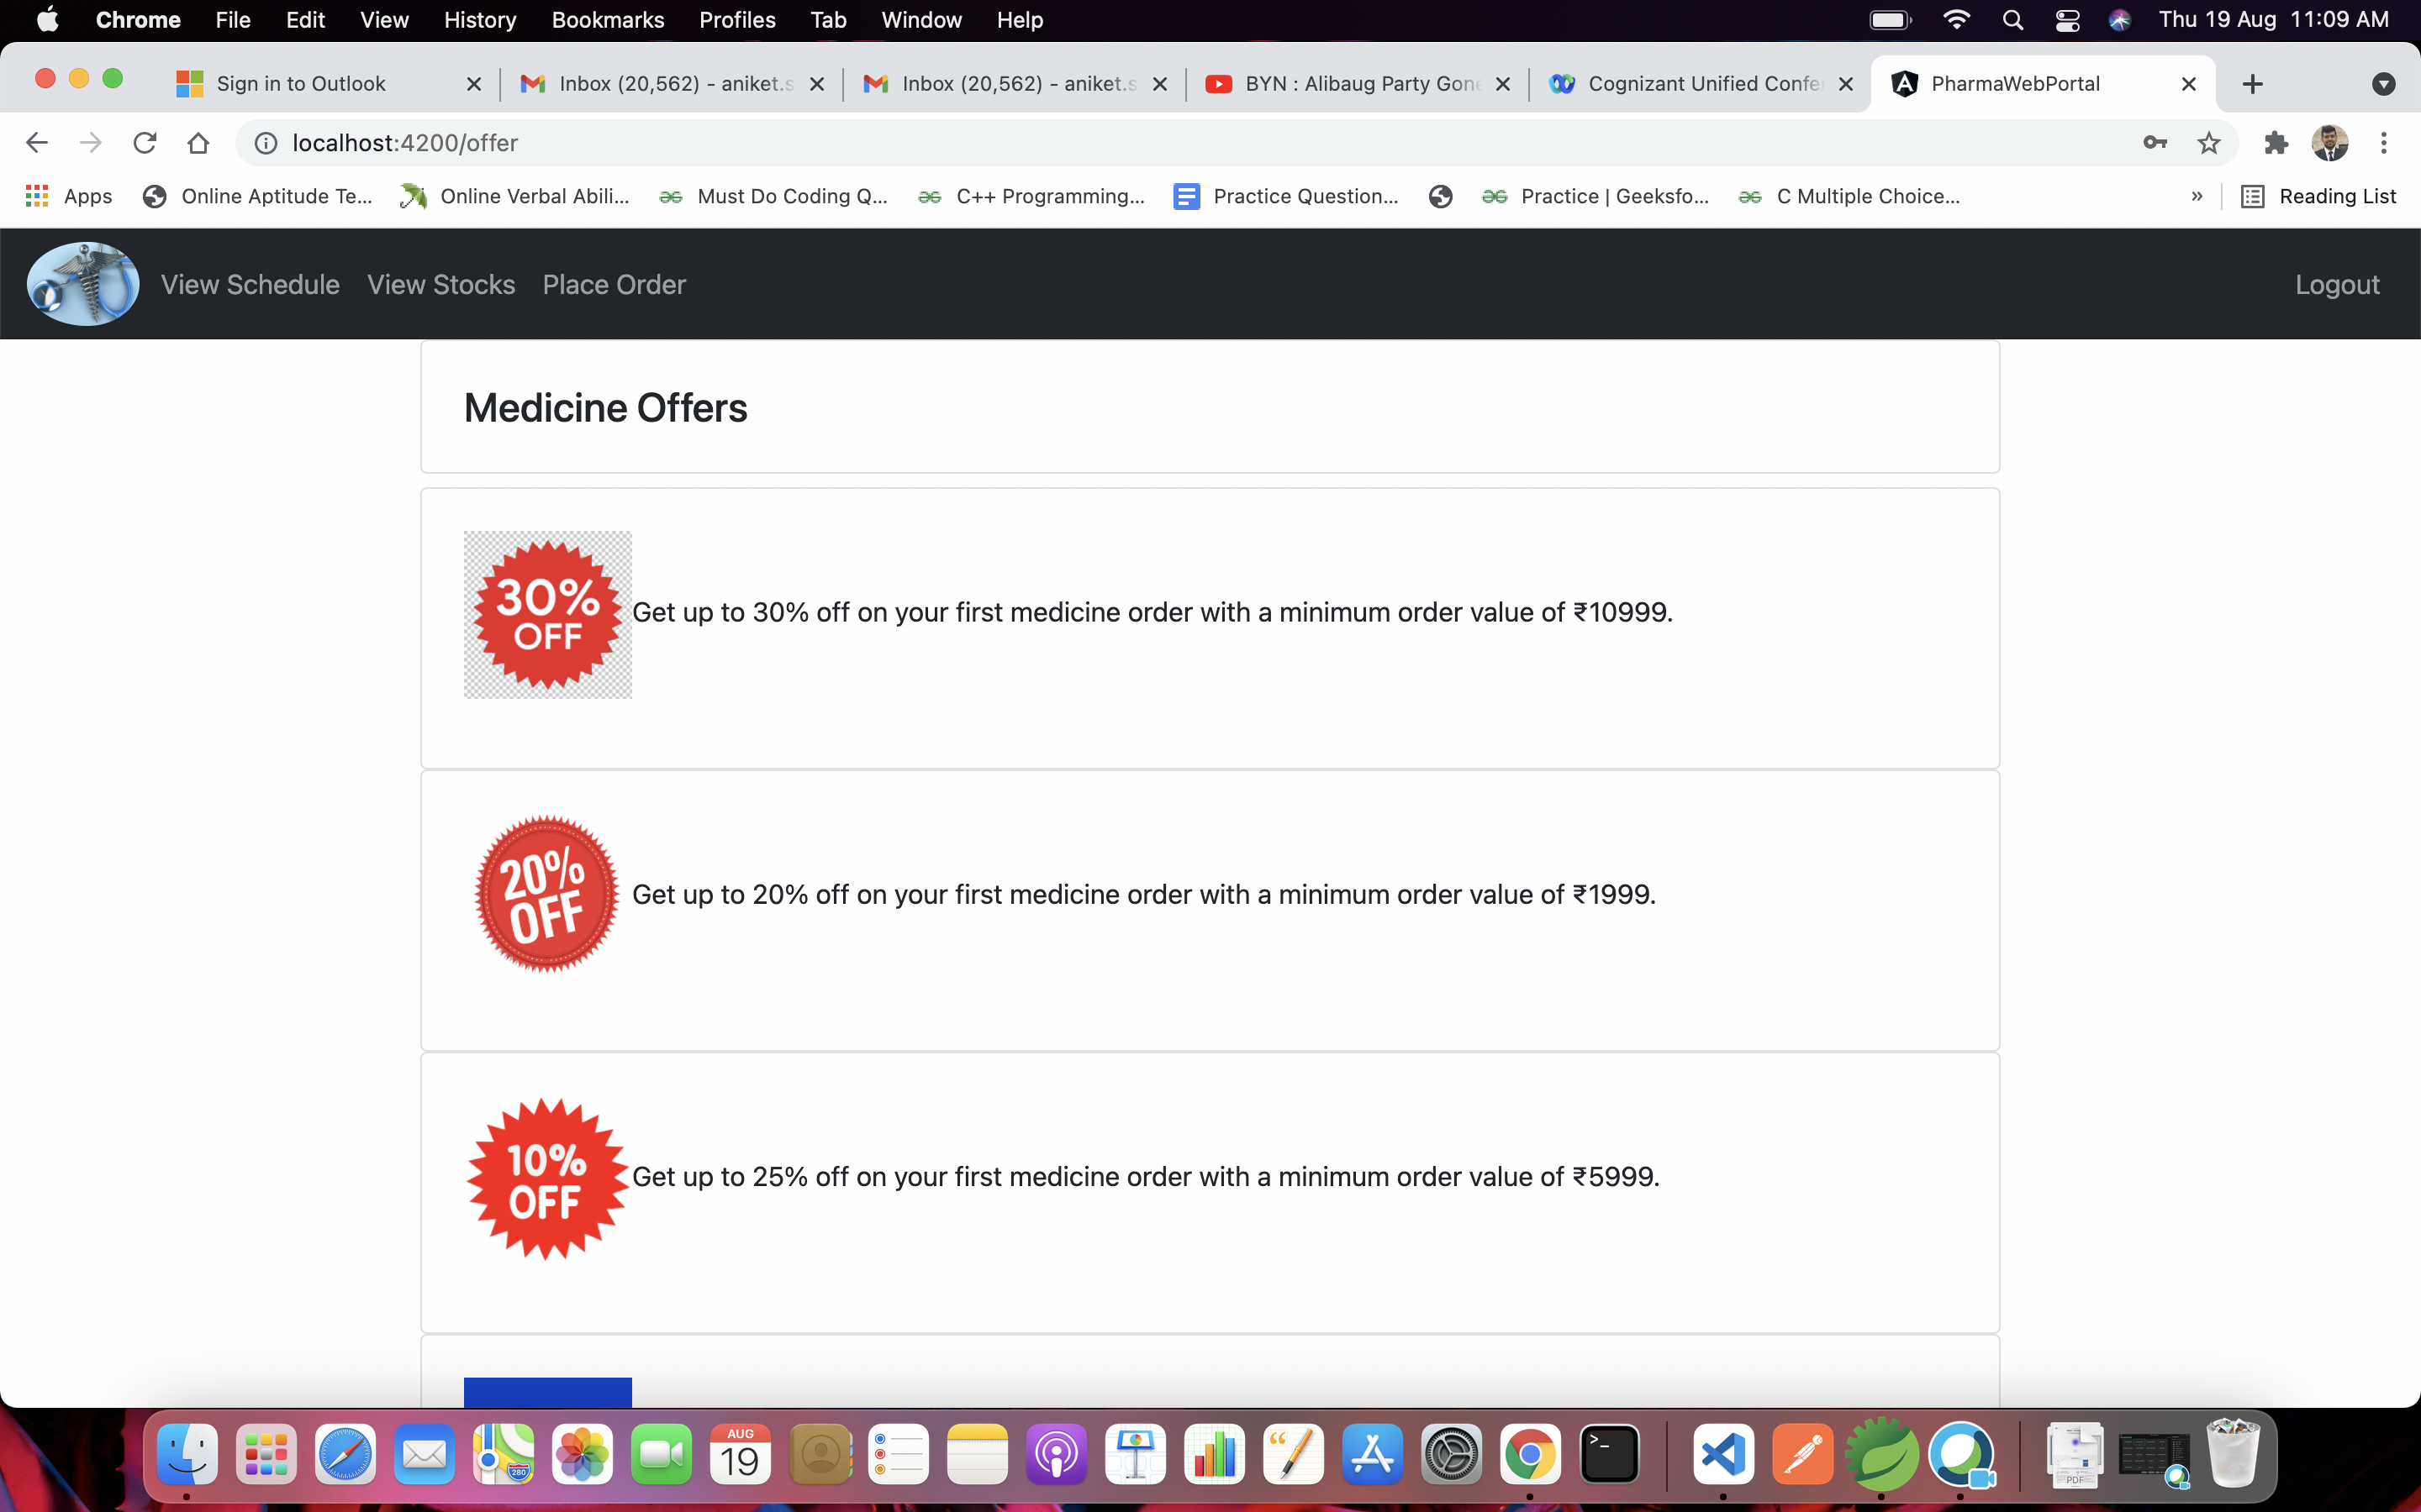
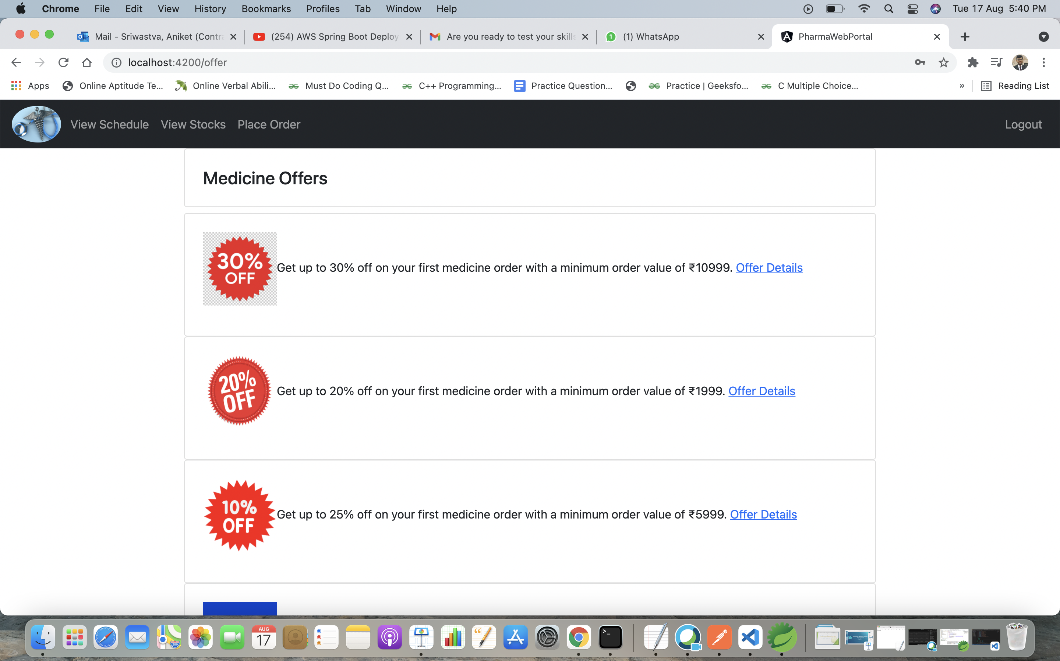
Offer Page

Slide 14
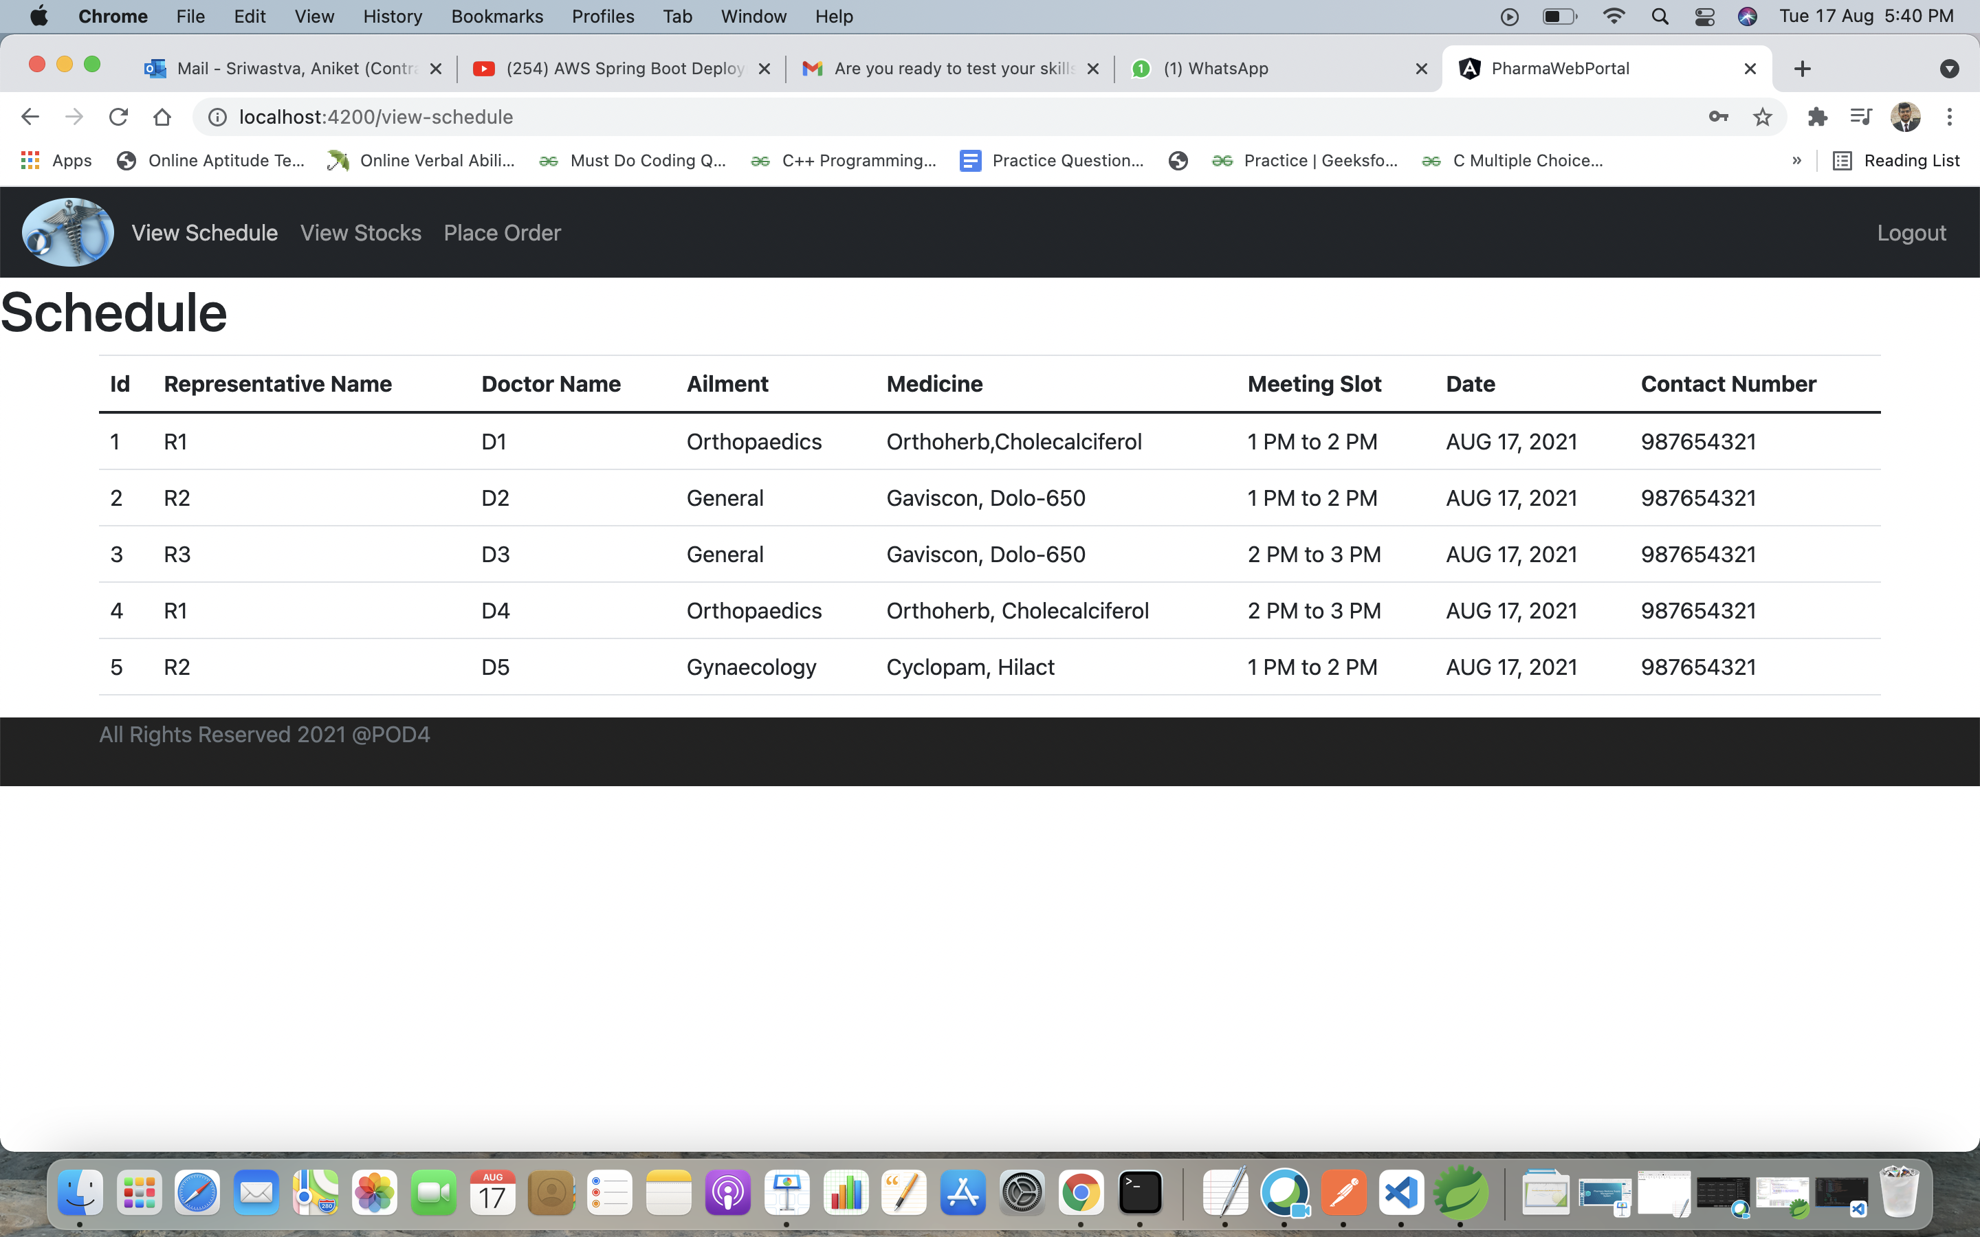
View Schedule

Slide 15
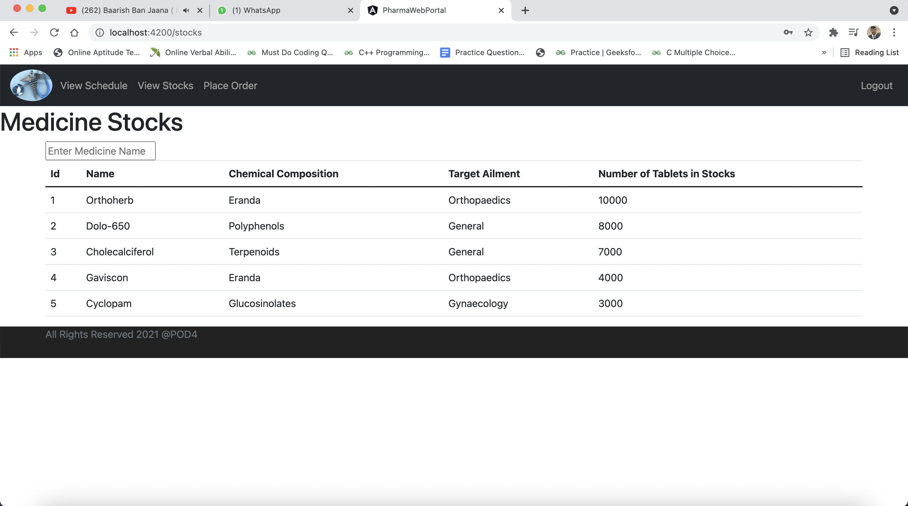
View Stocks

Slide 16
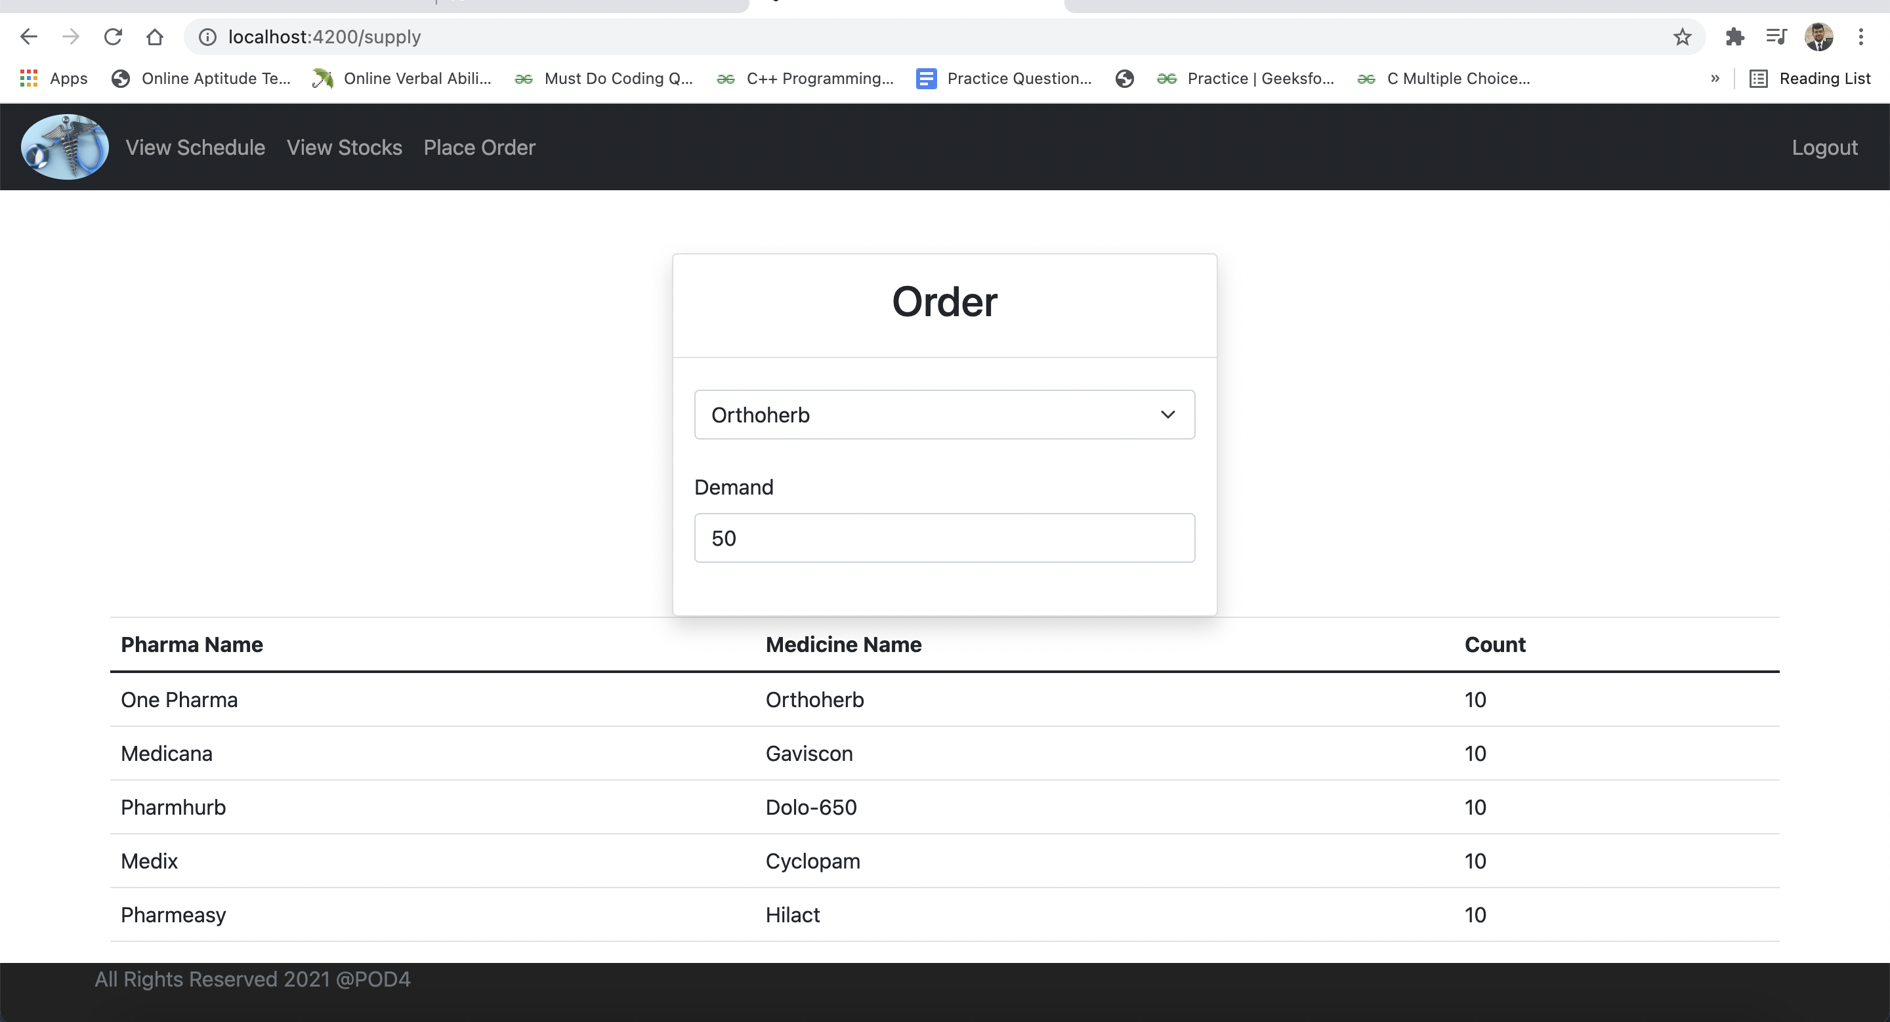
Place Order

Slide 17
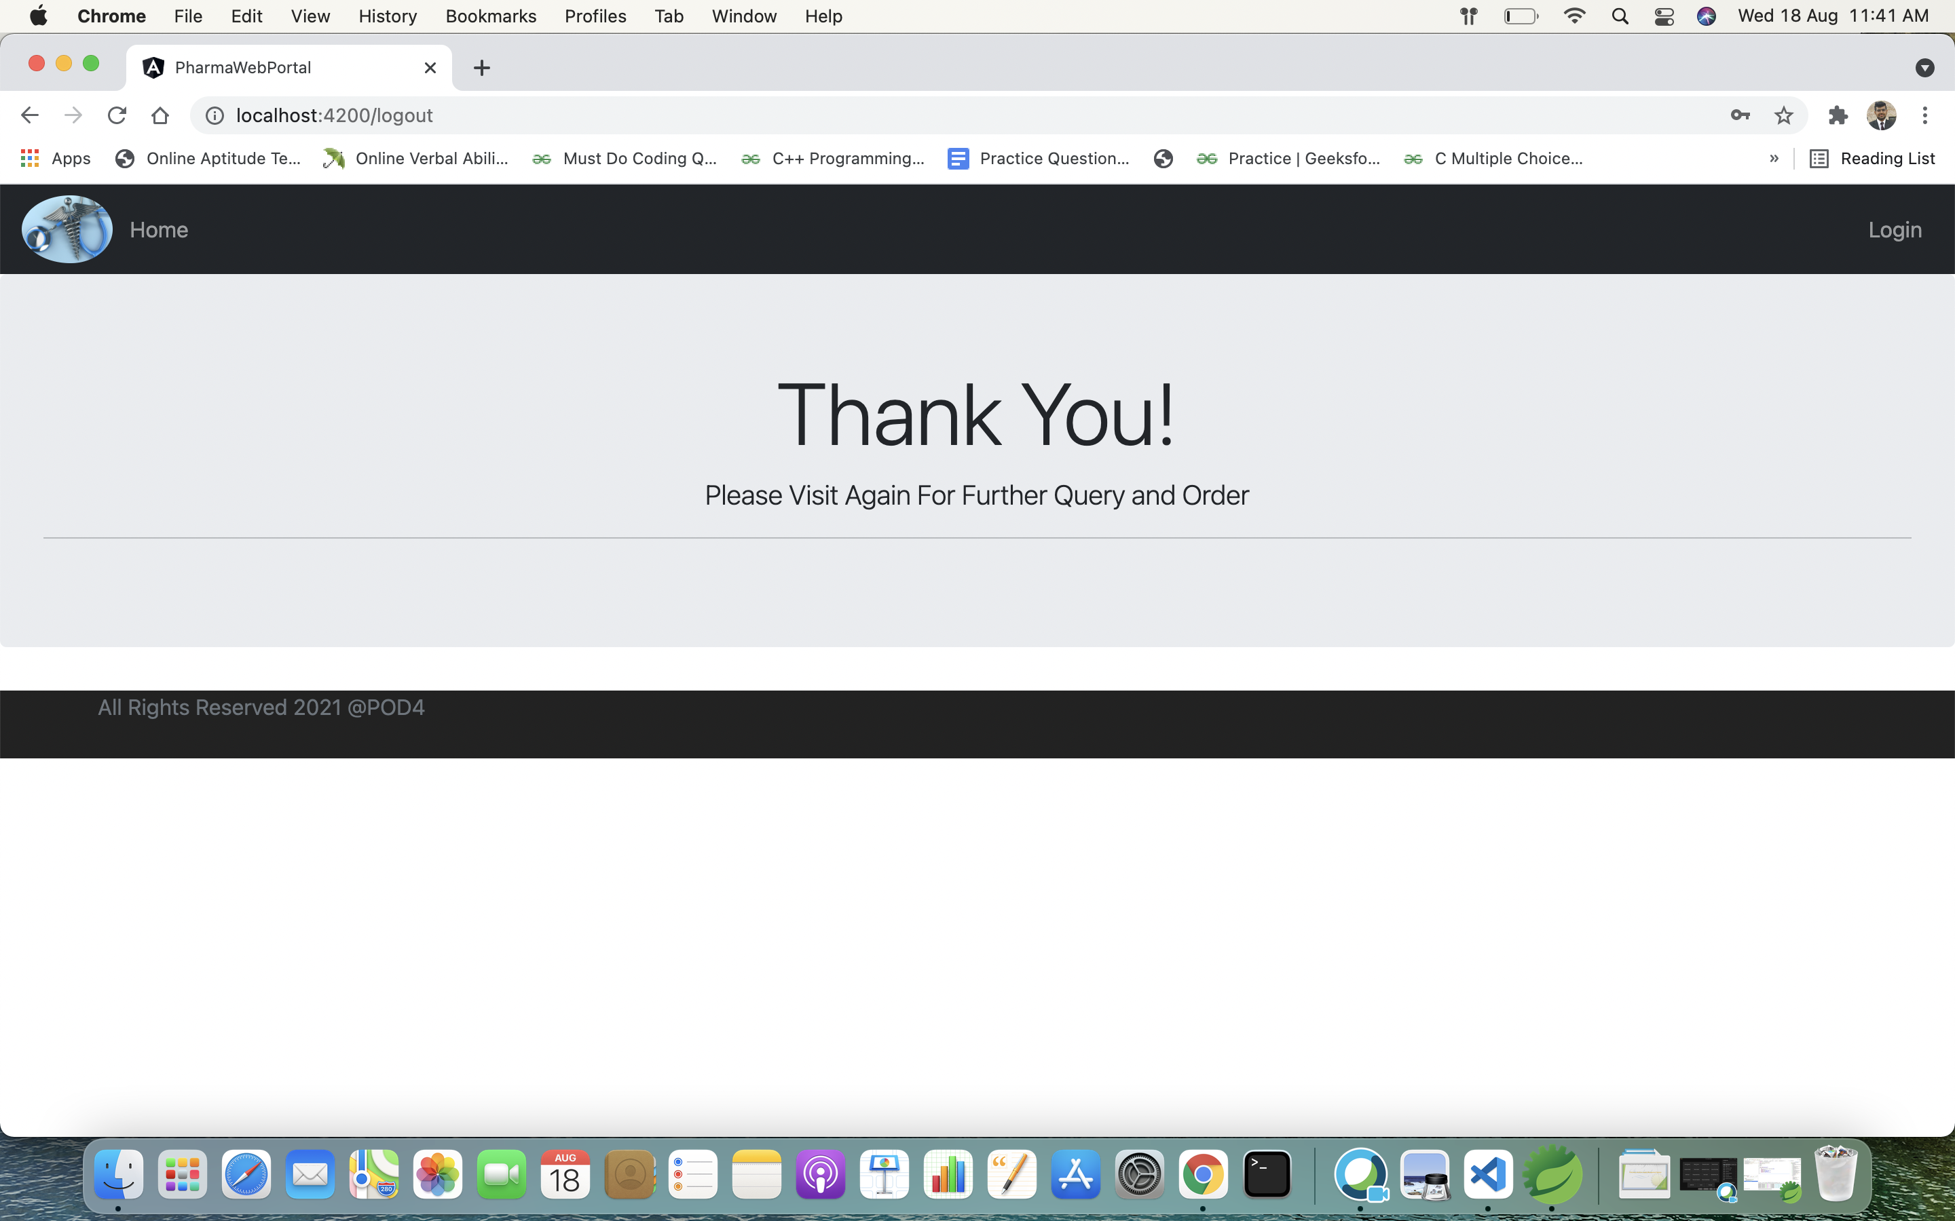
Log out

Slide 18
Backend API Using Postman and Swagger

Slide 19
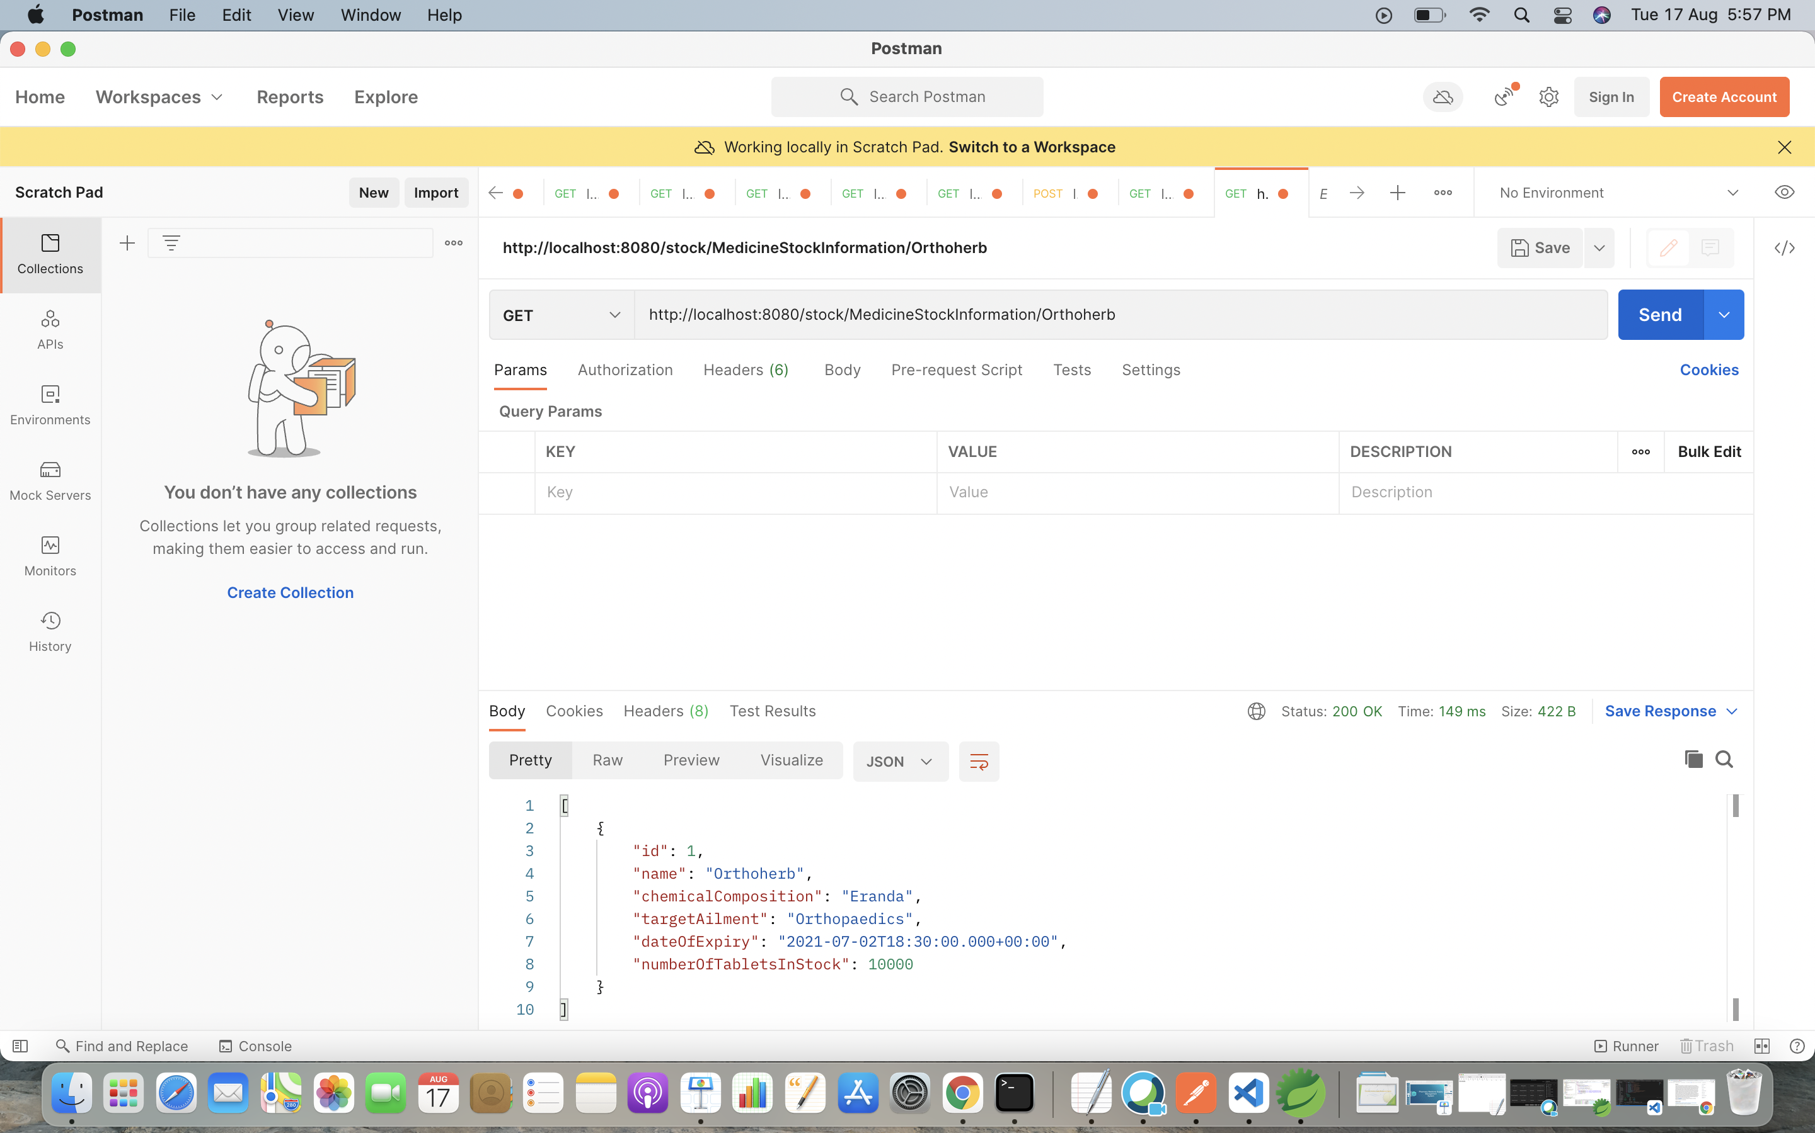
Medicine Stock Microservice

Slide 20
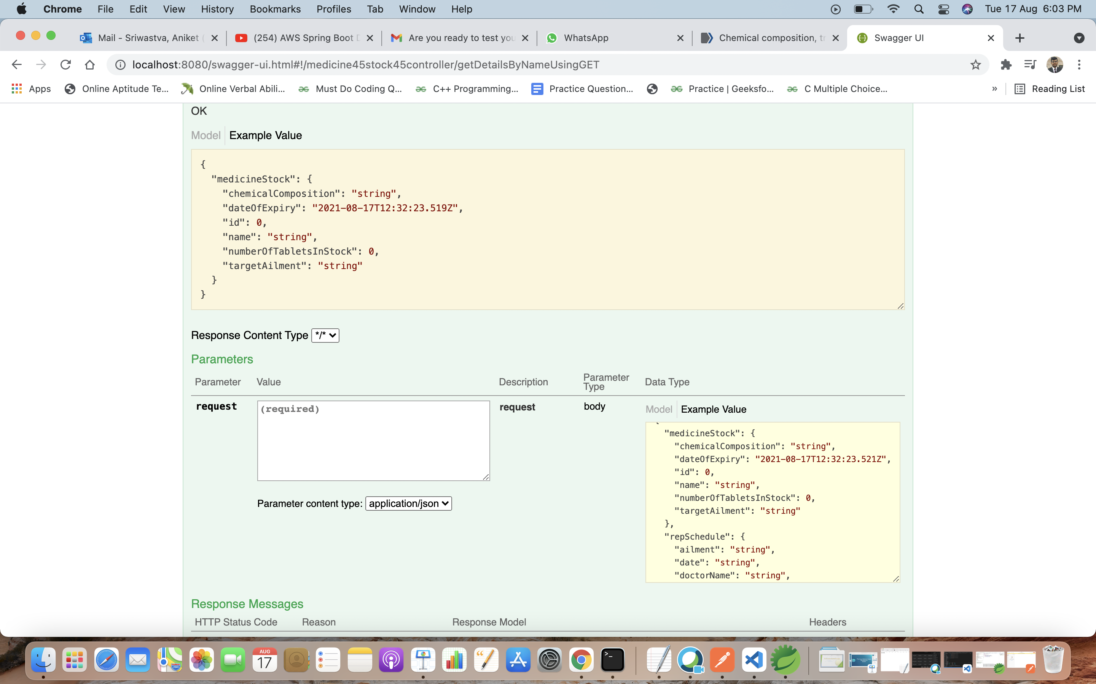
Communication between Medicine Stock Microservice and Medicine Representative Microservice

Slide 21
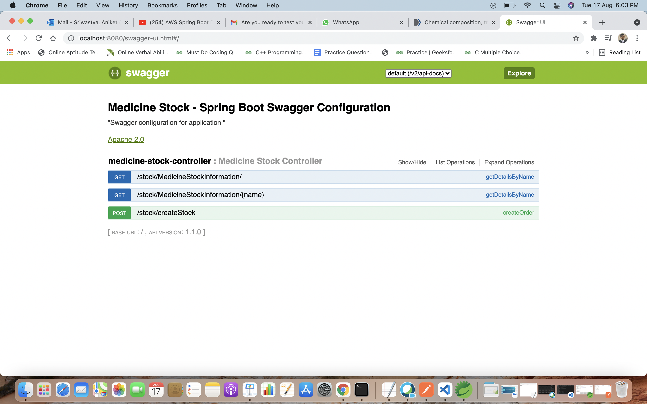
Swagger

Slide 22
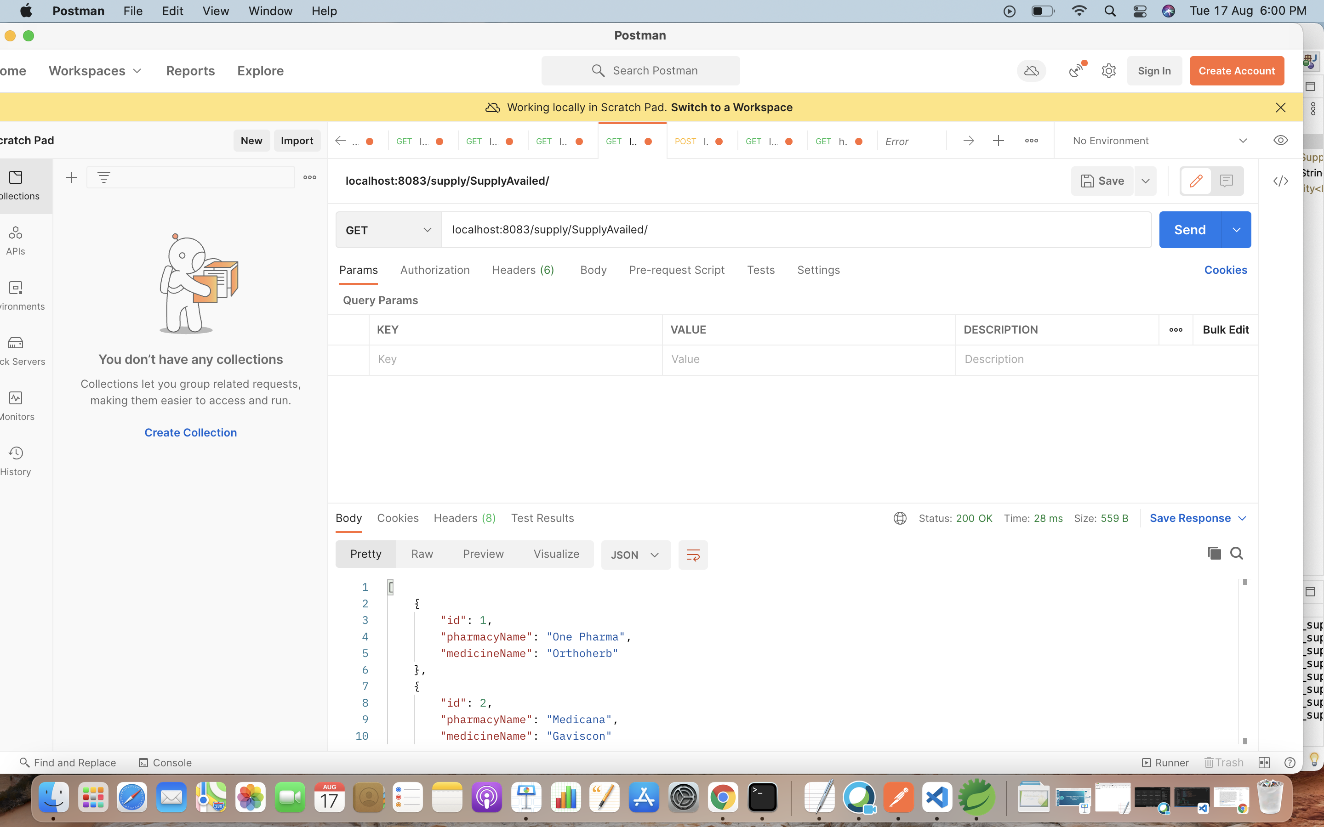
Medicine Supply Microservice

Slide 23
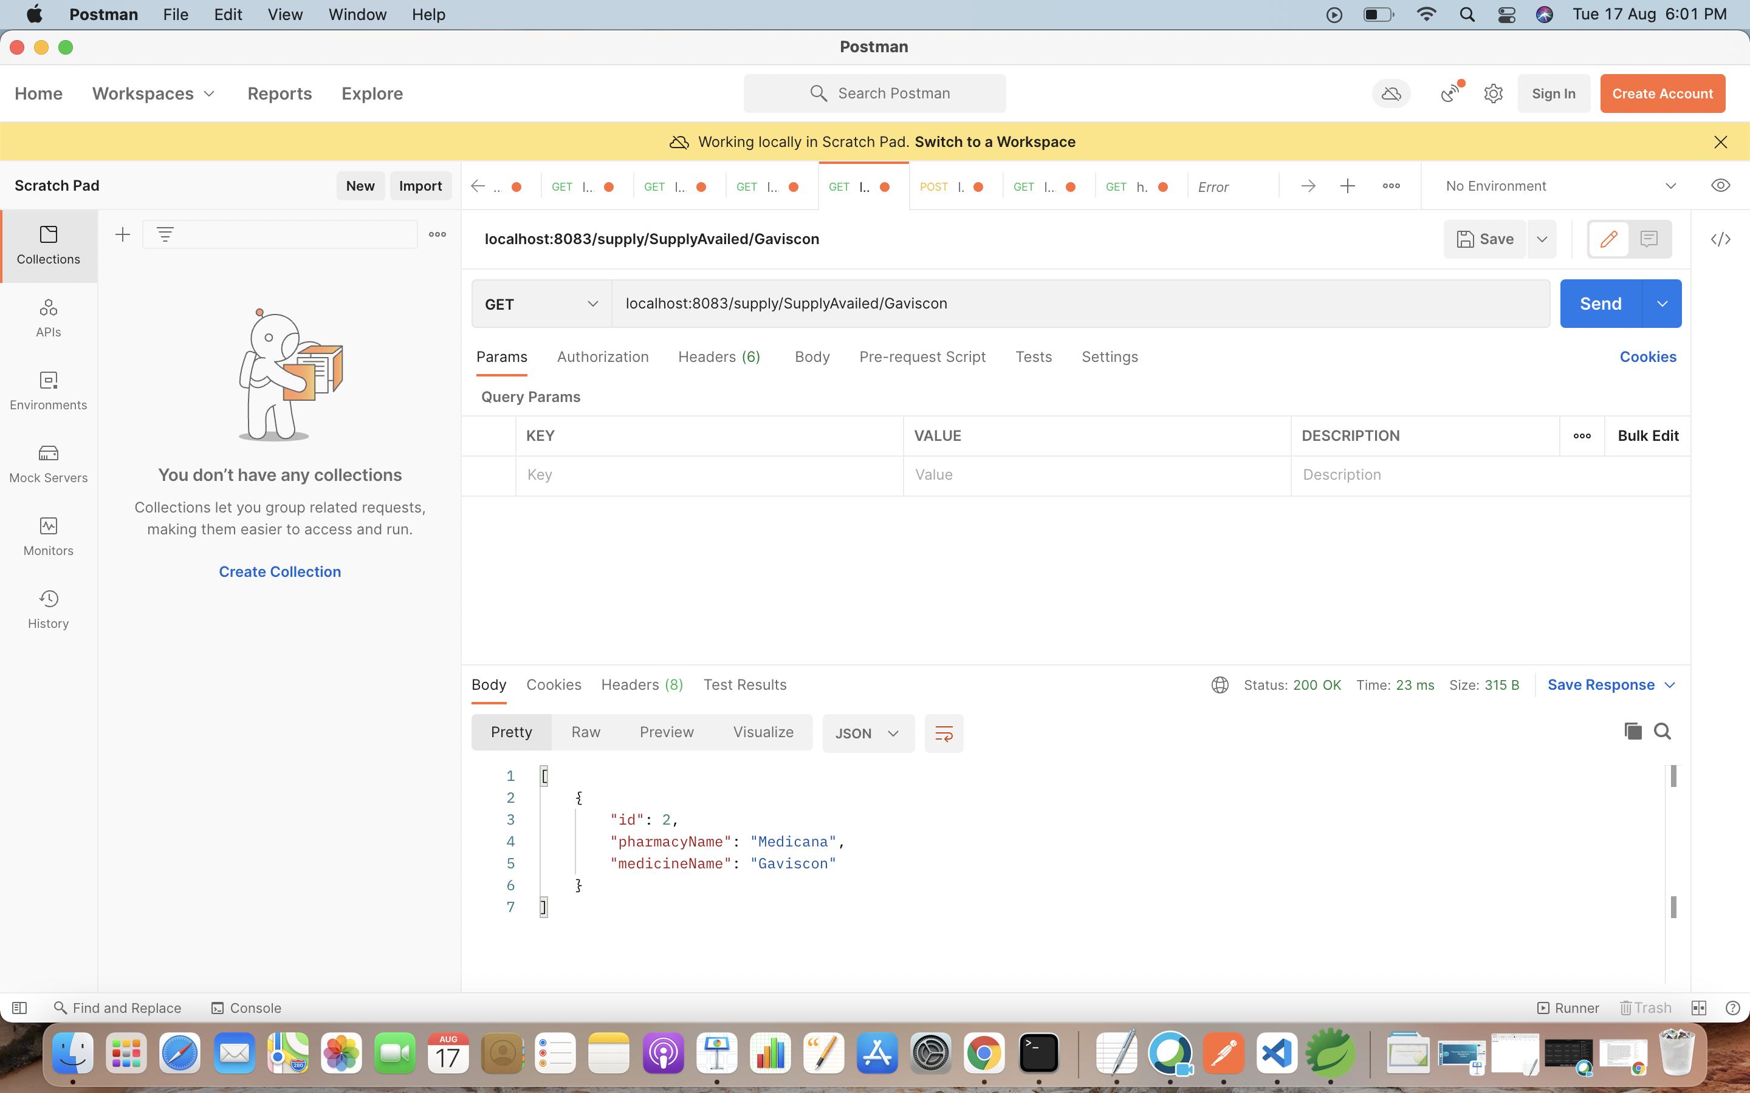
Search By Name

Slide 24
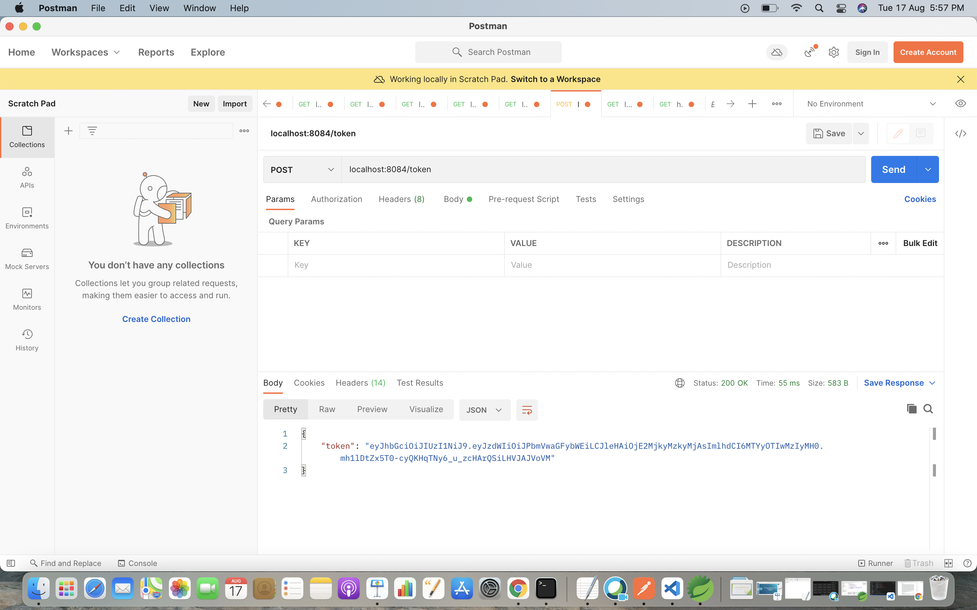
Authorization Microservice

Slide 25
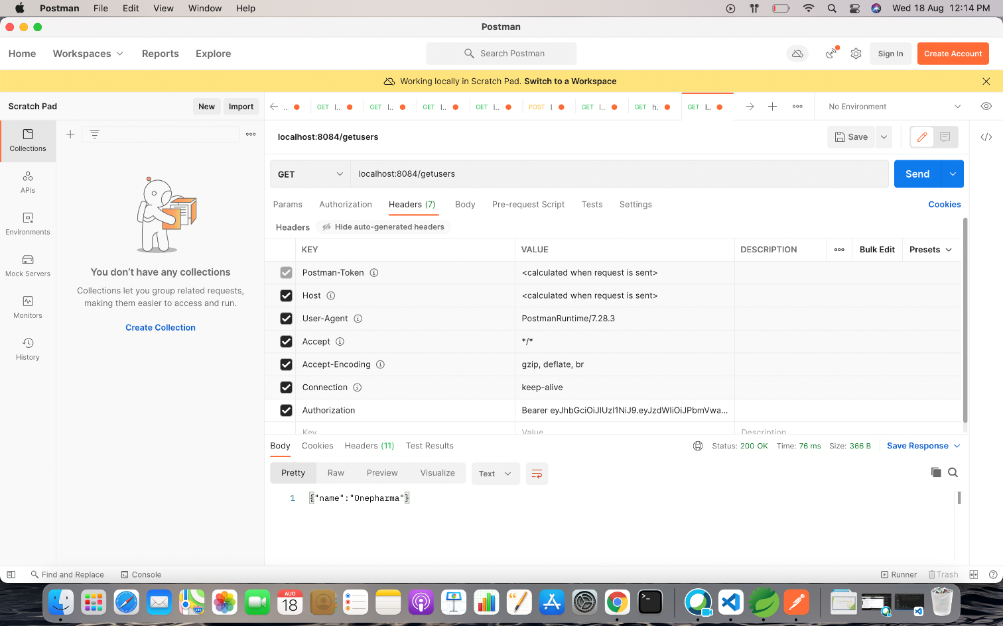
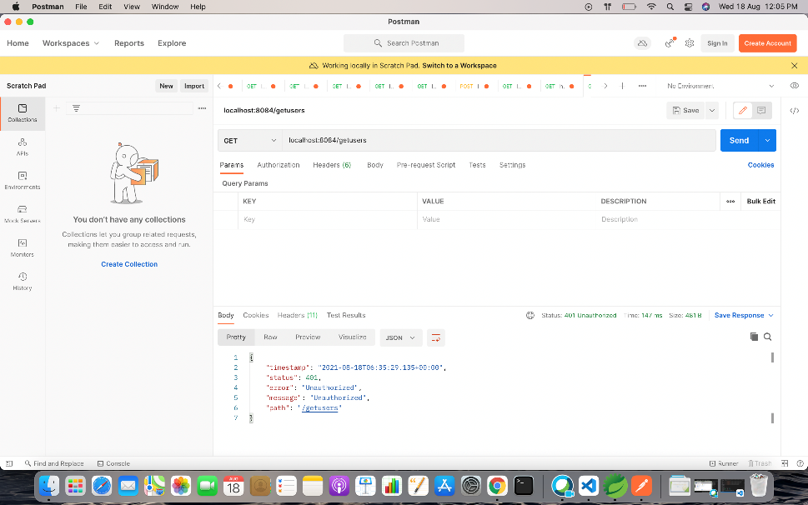

Slide 26

Cloud Deployment

Slide 27
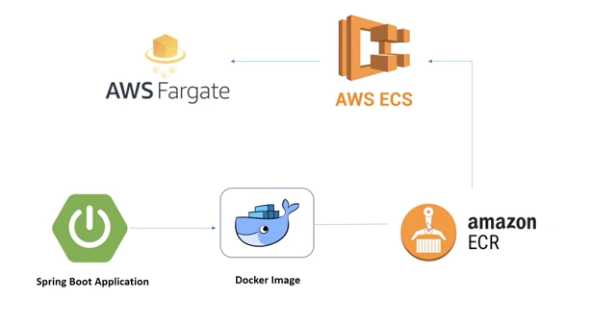

Slide 28
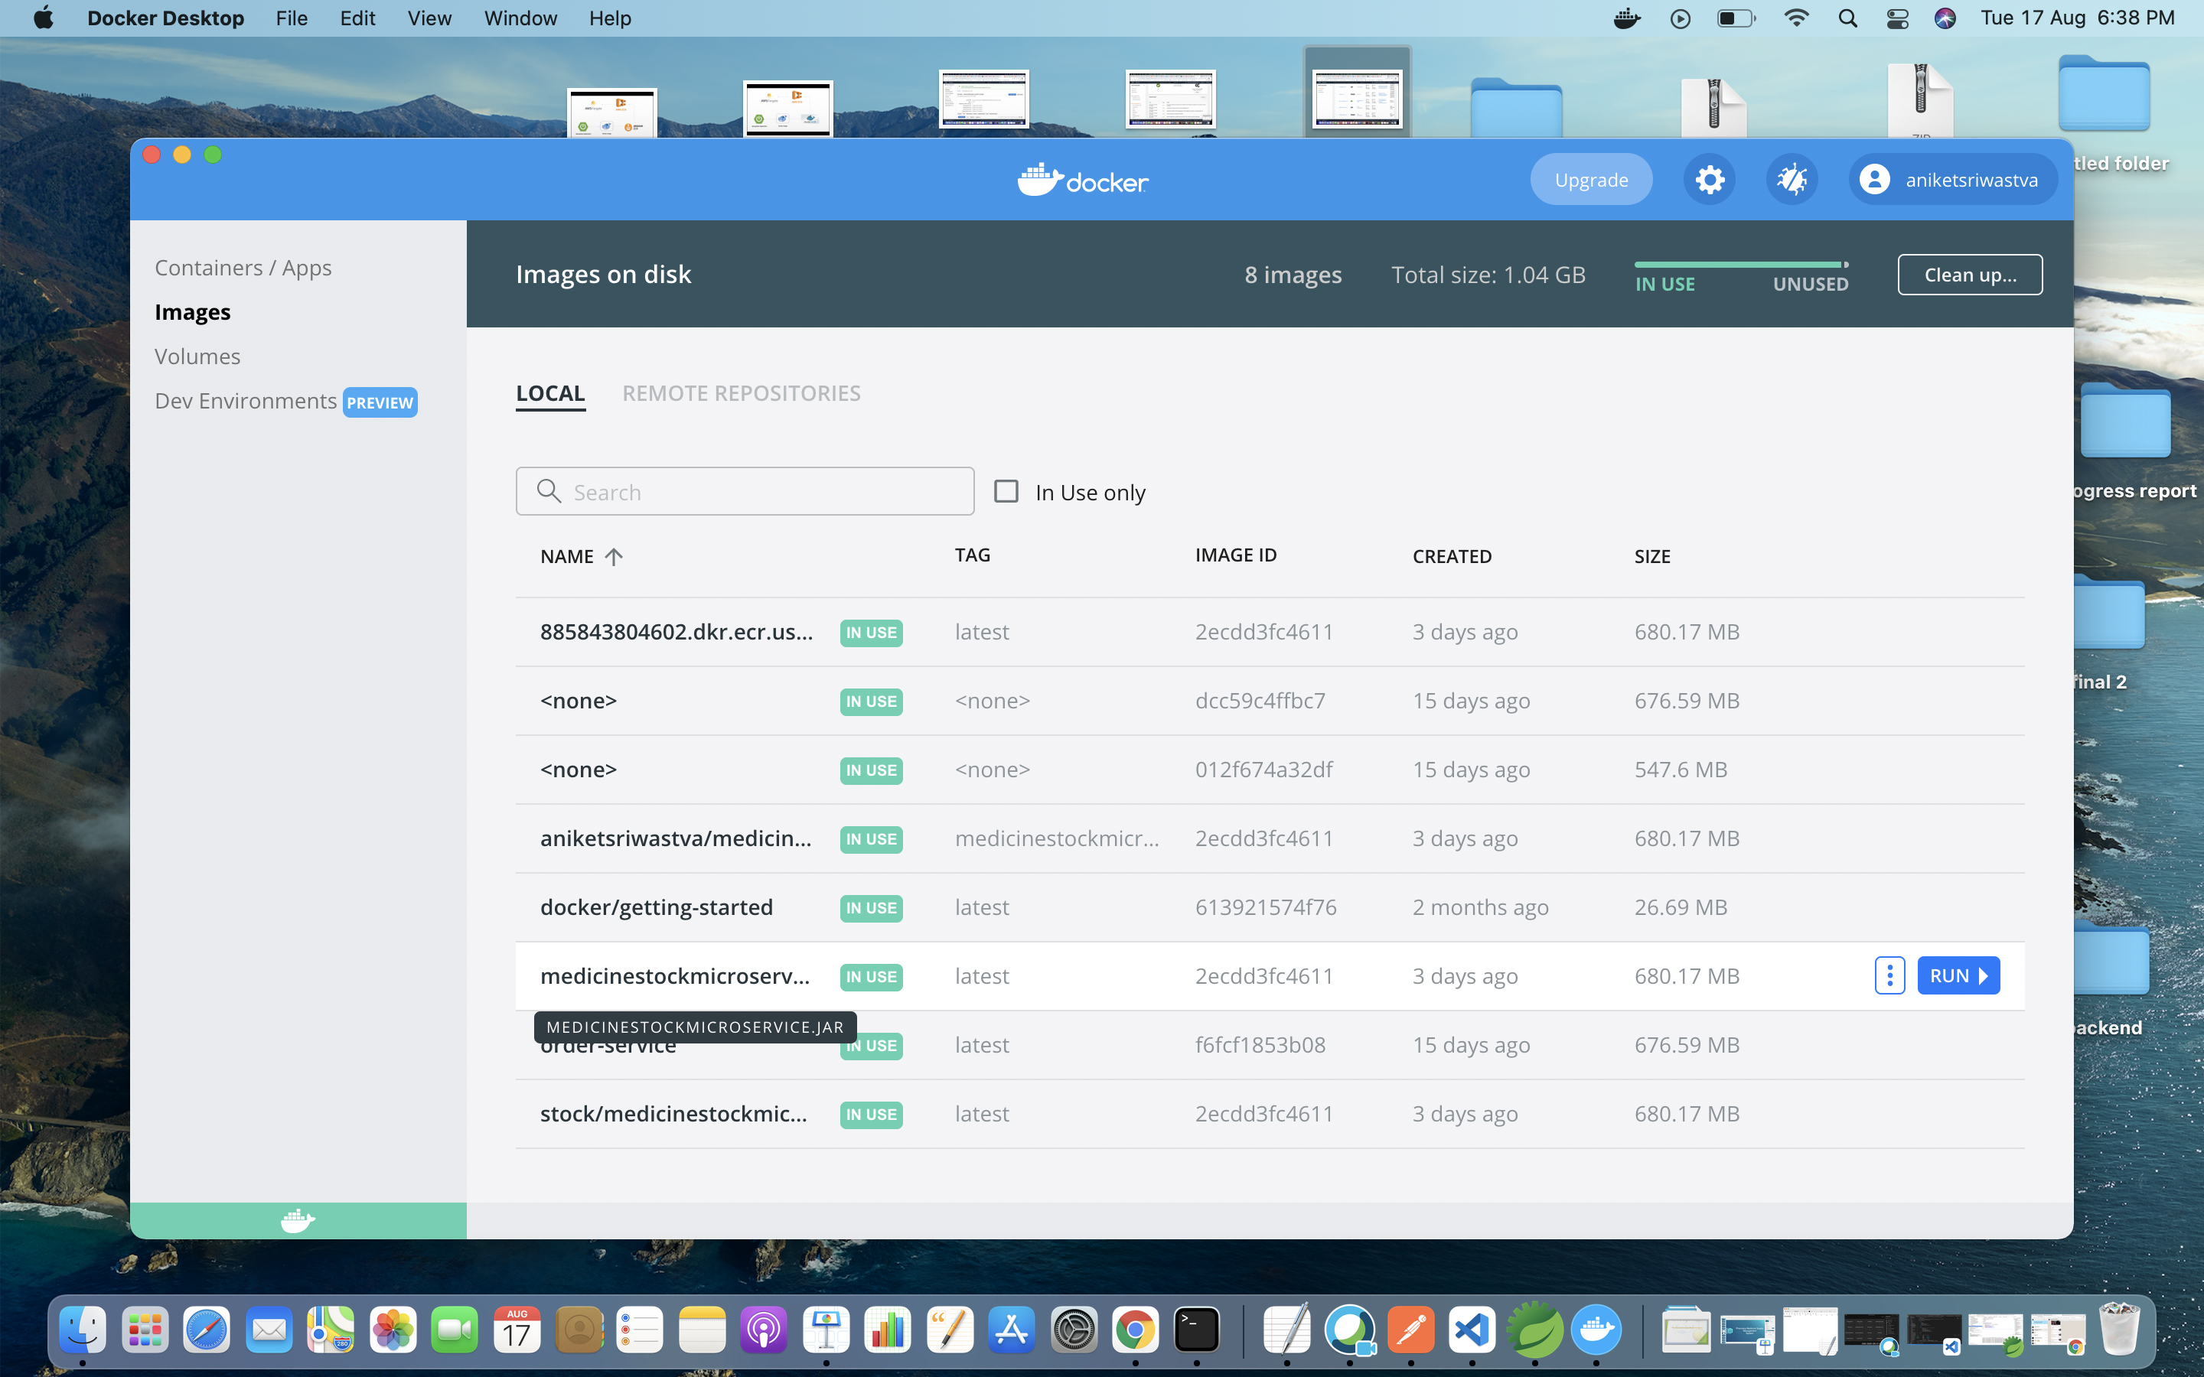
Docker Image

Slide 29
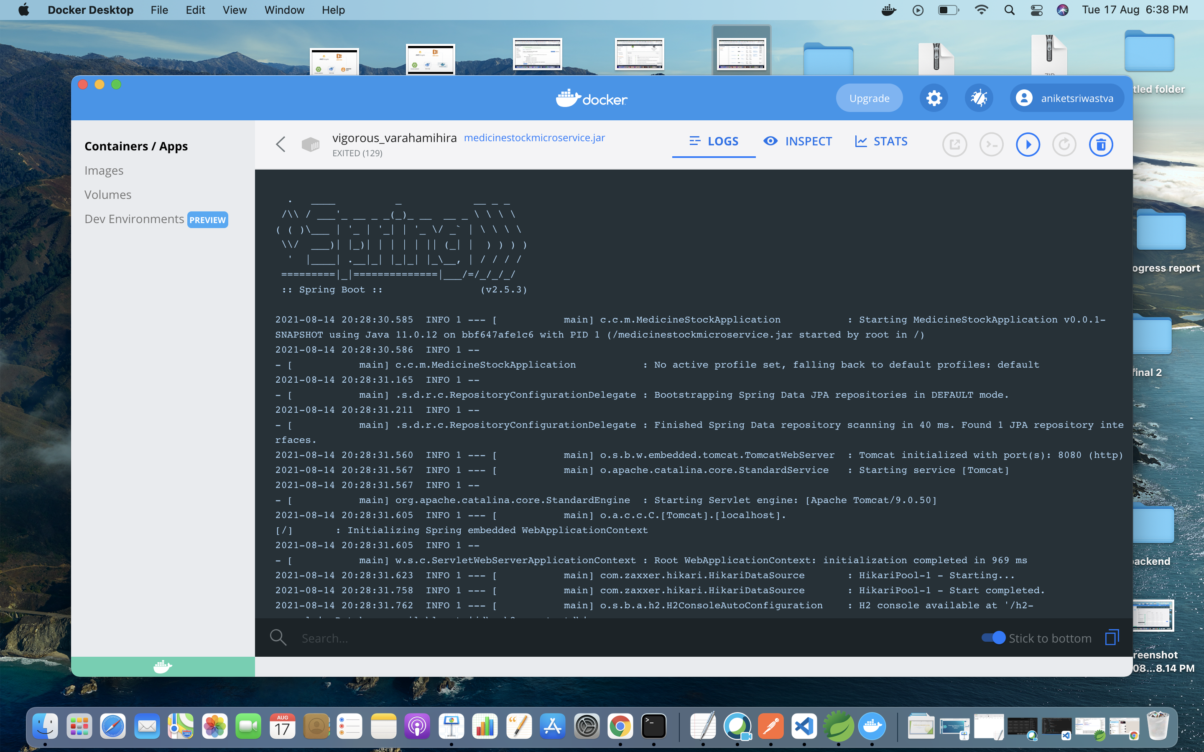

Slide 30
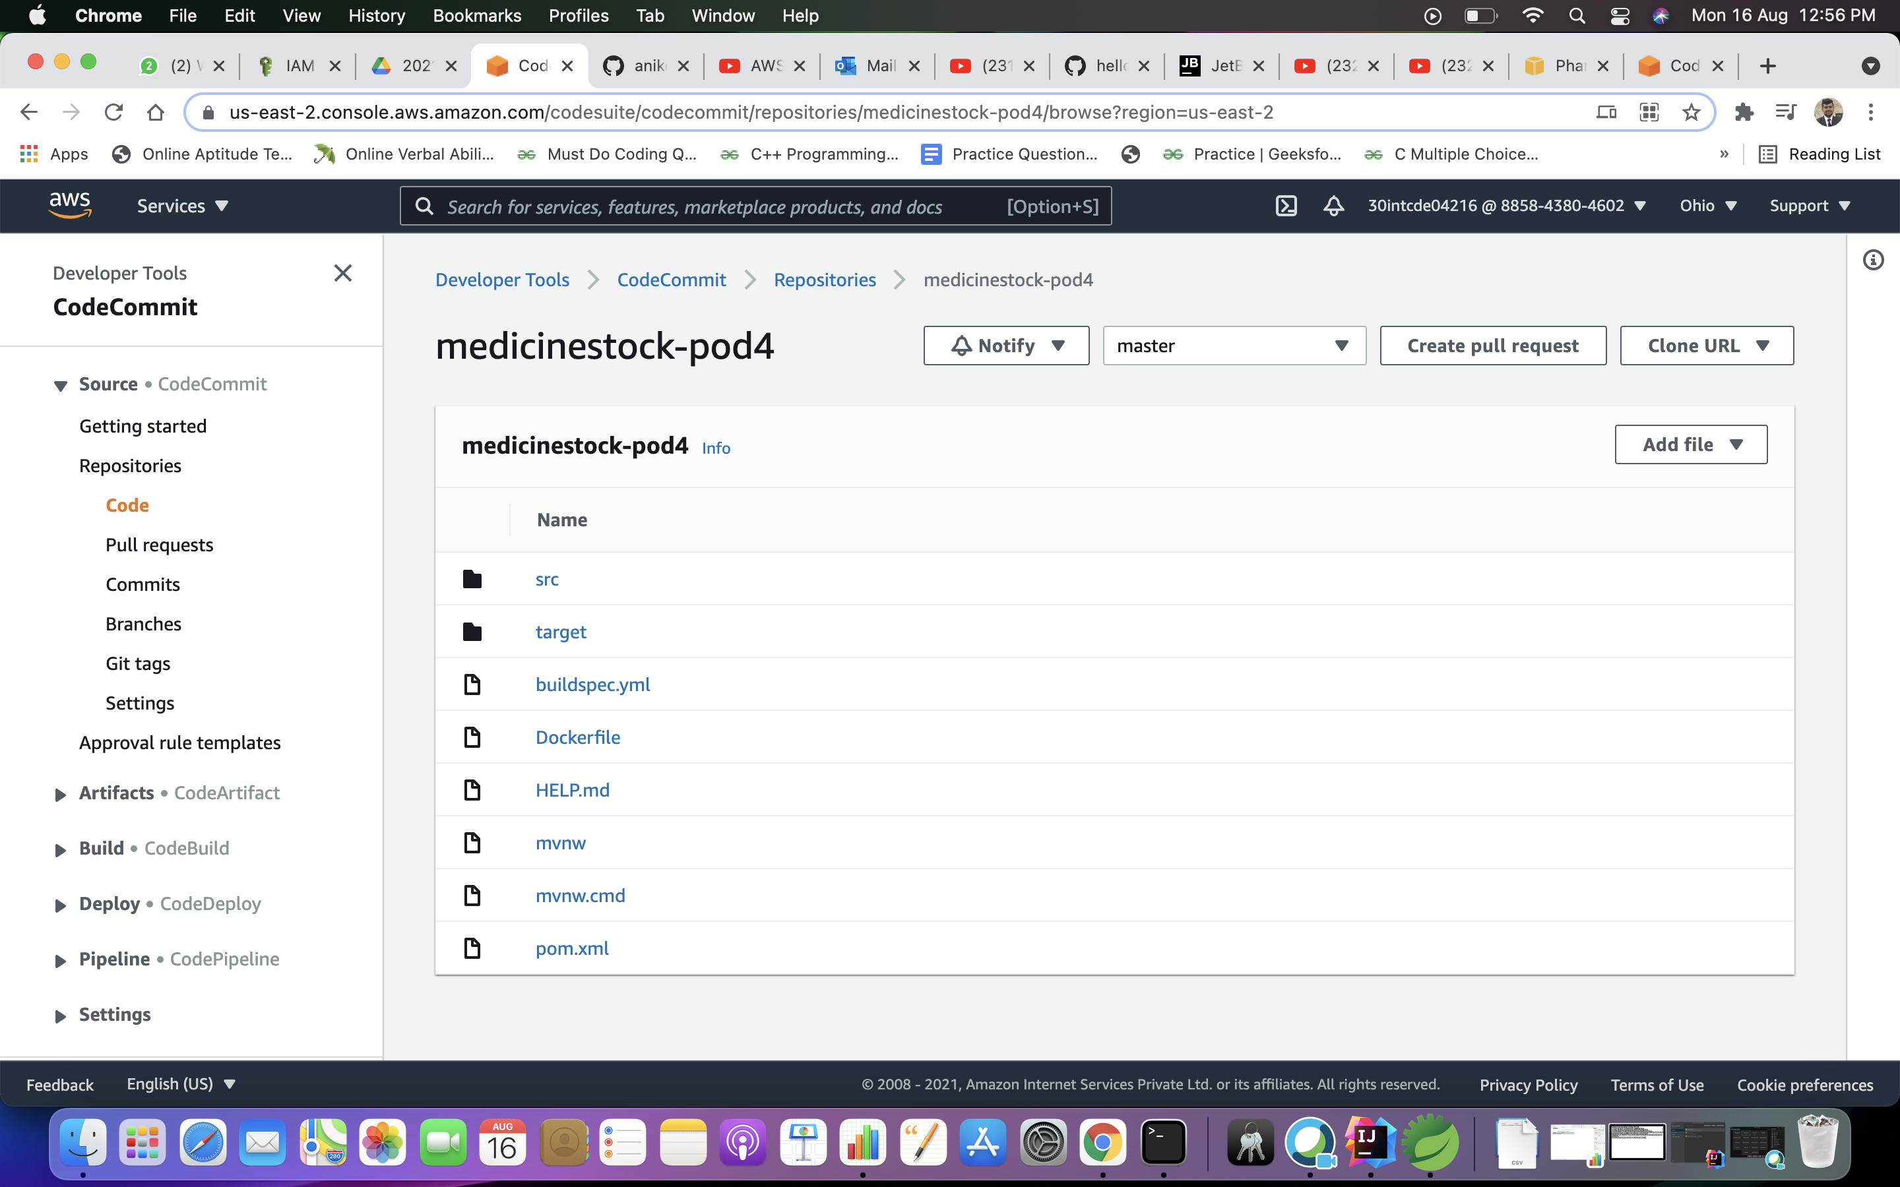
Code Commit

Slide 31
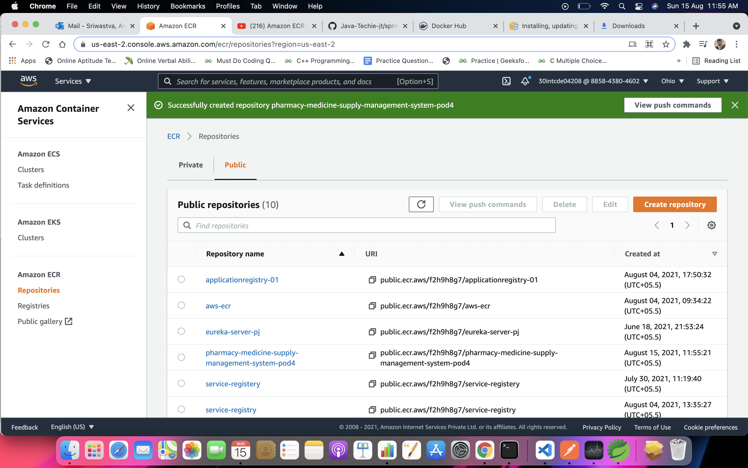
ECR

Slide 32
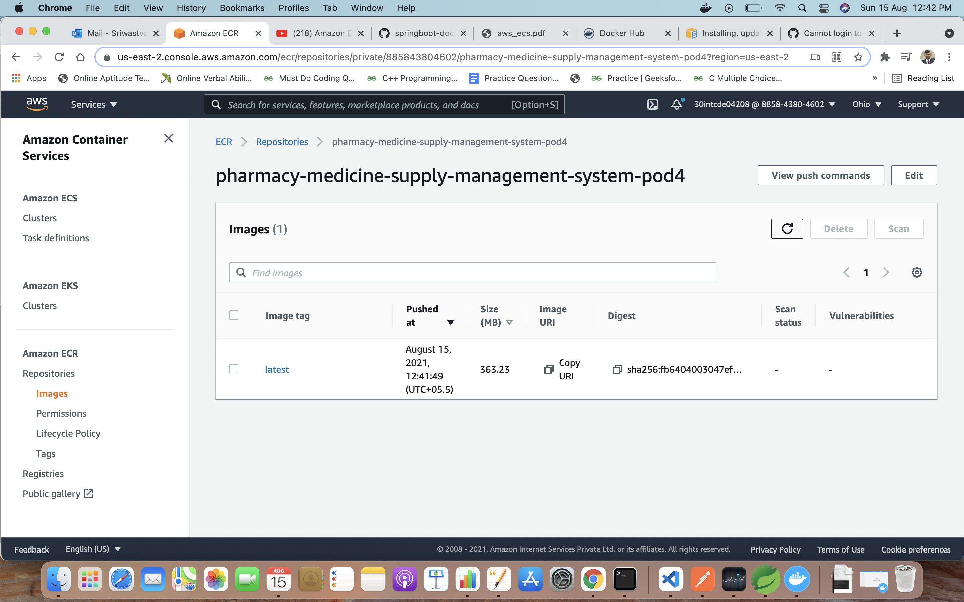

Slide 33
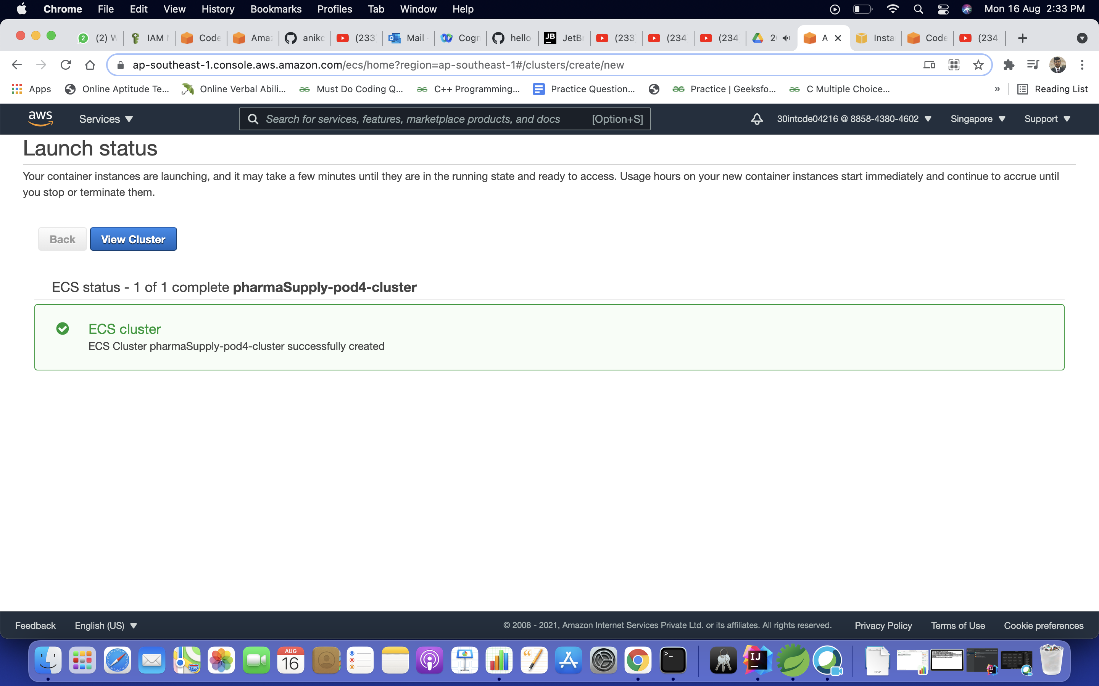
Cluster

Slide 34
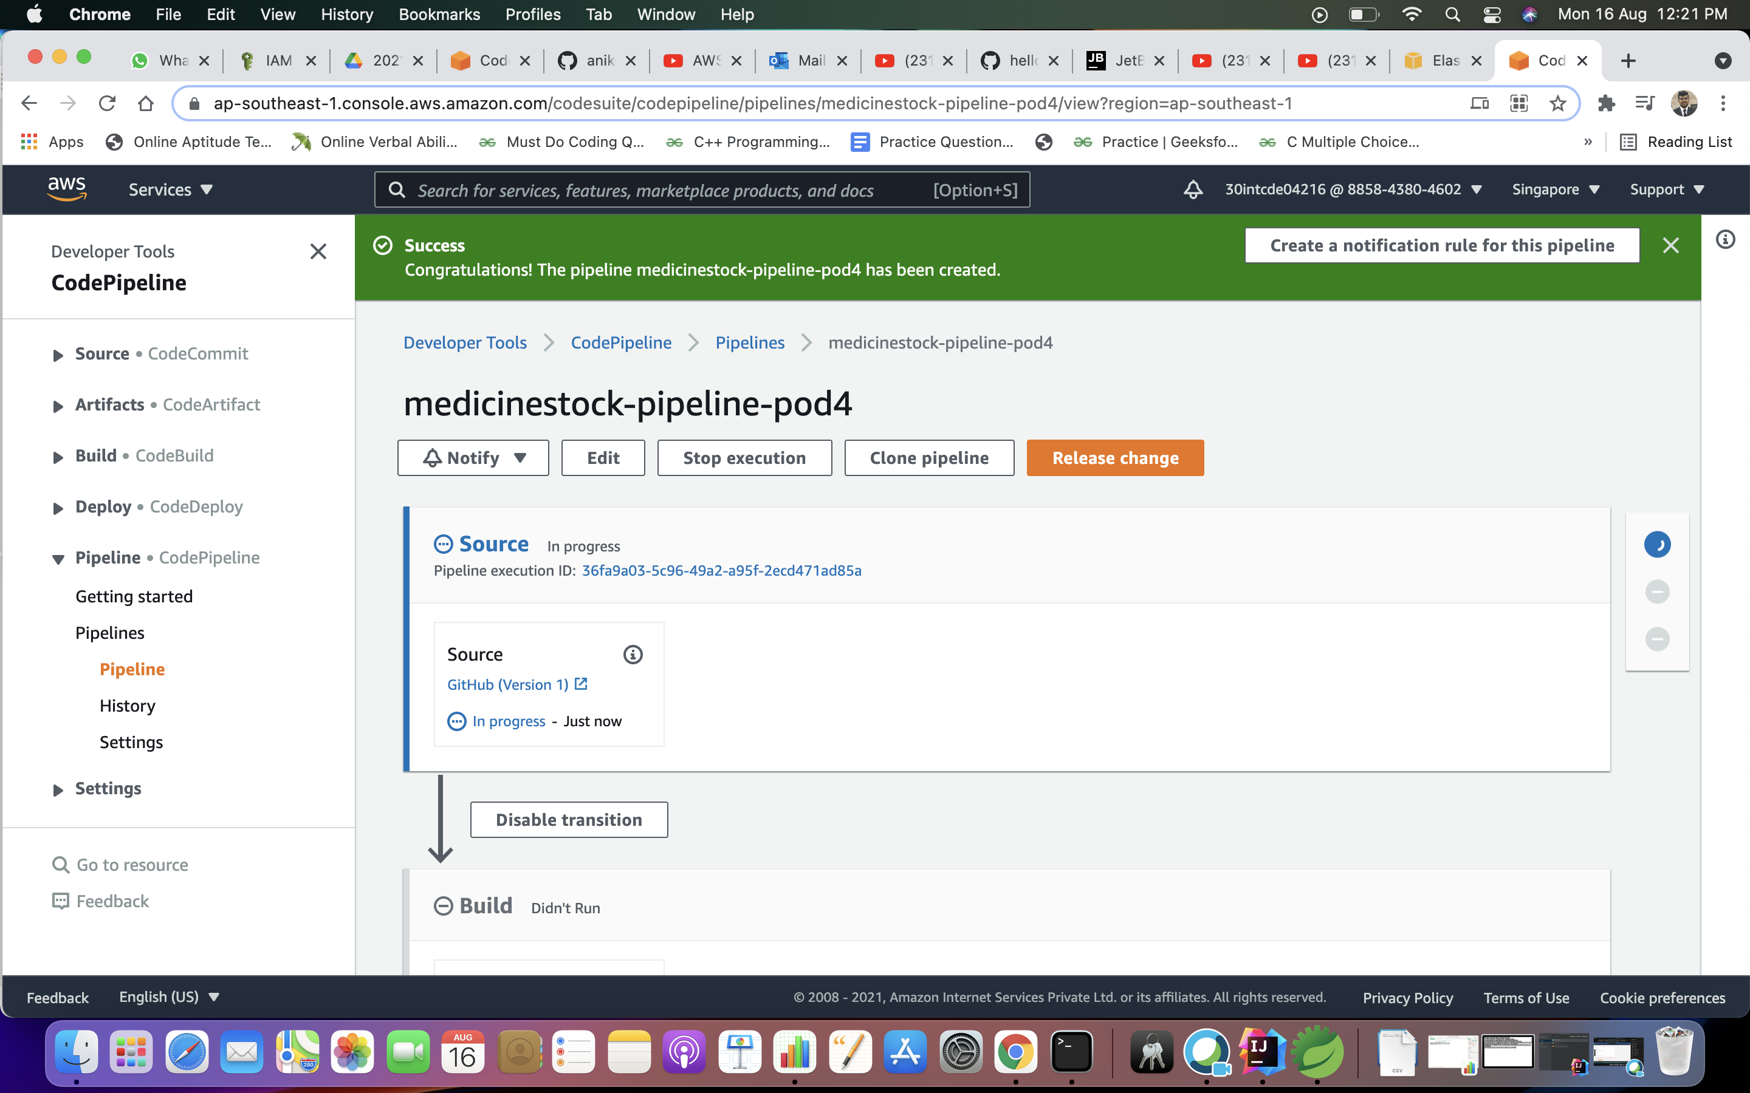
PipeLine

Slide 35
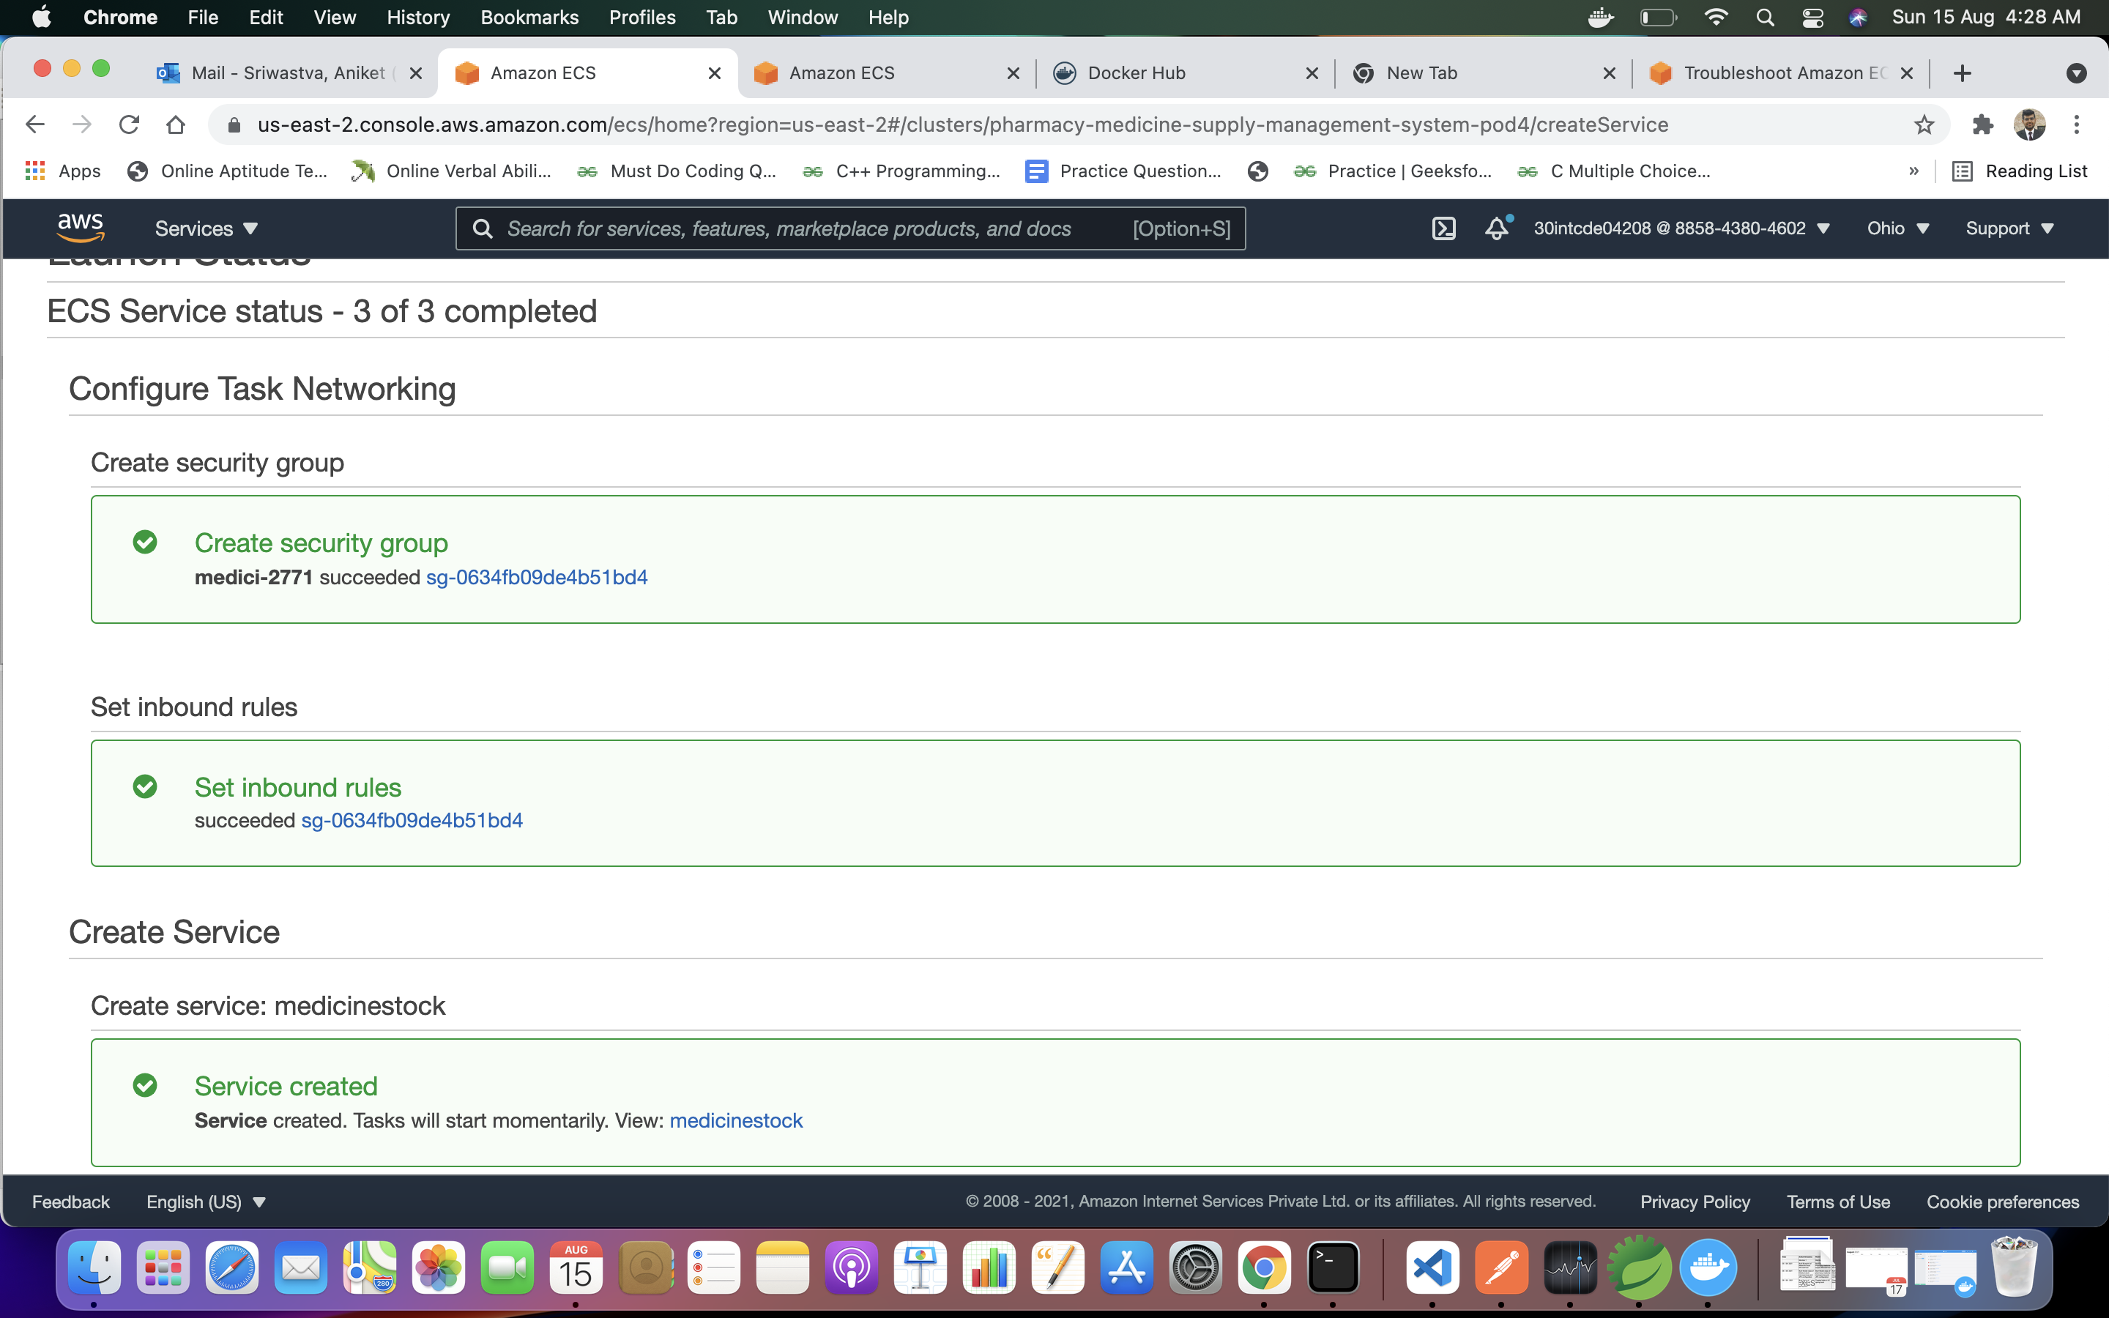
ECS

Slide 36
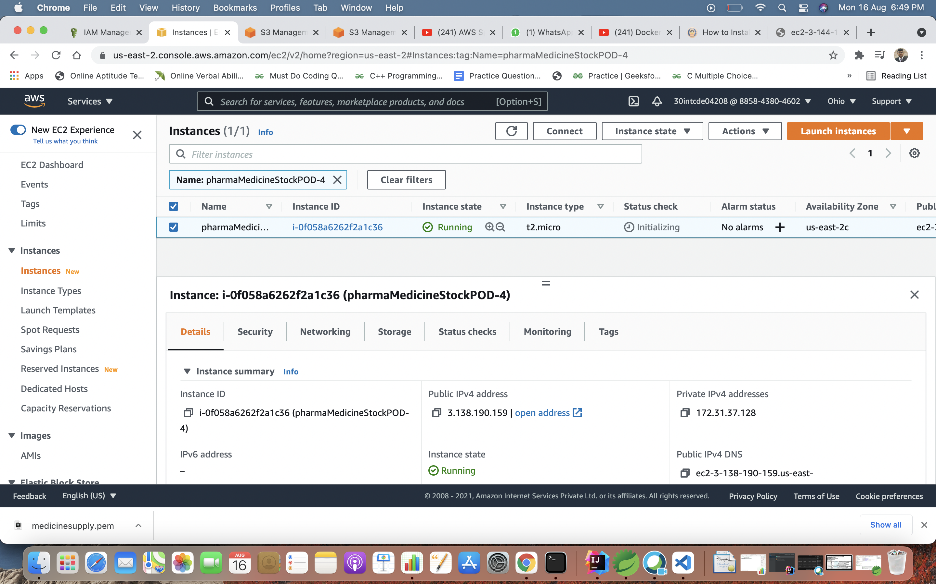
Medicine Stock Microservice Deployment

Slide 37
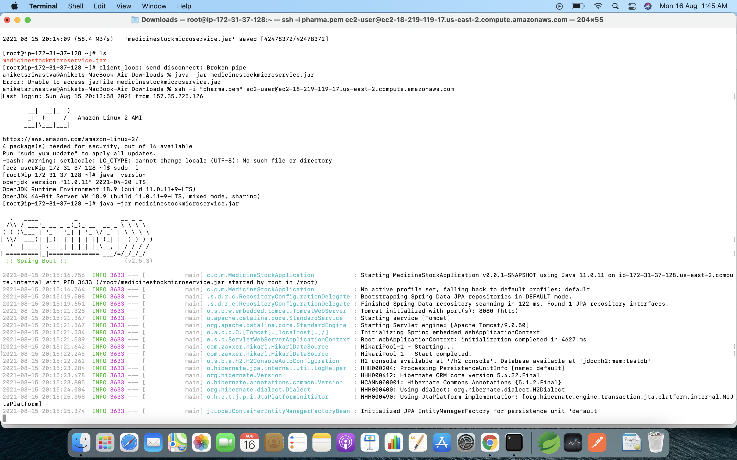

Slide 38
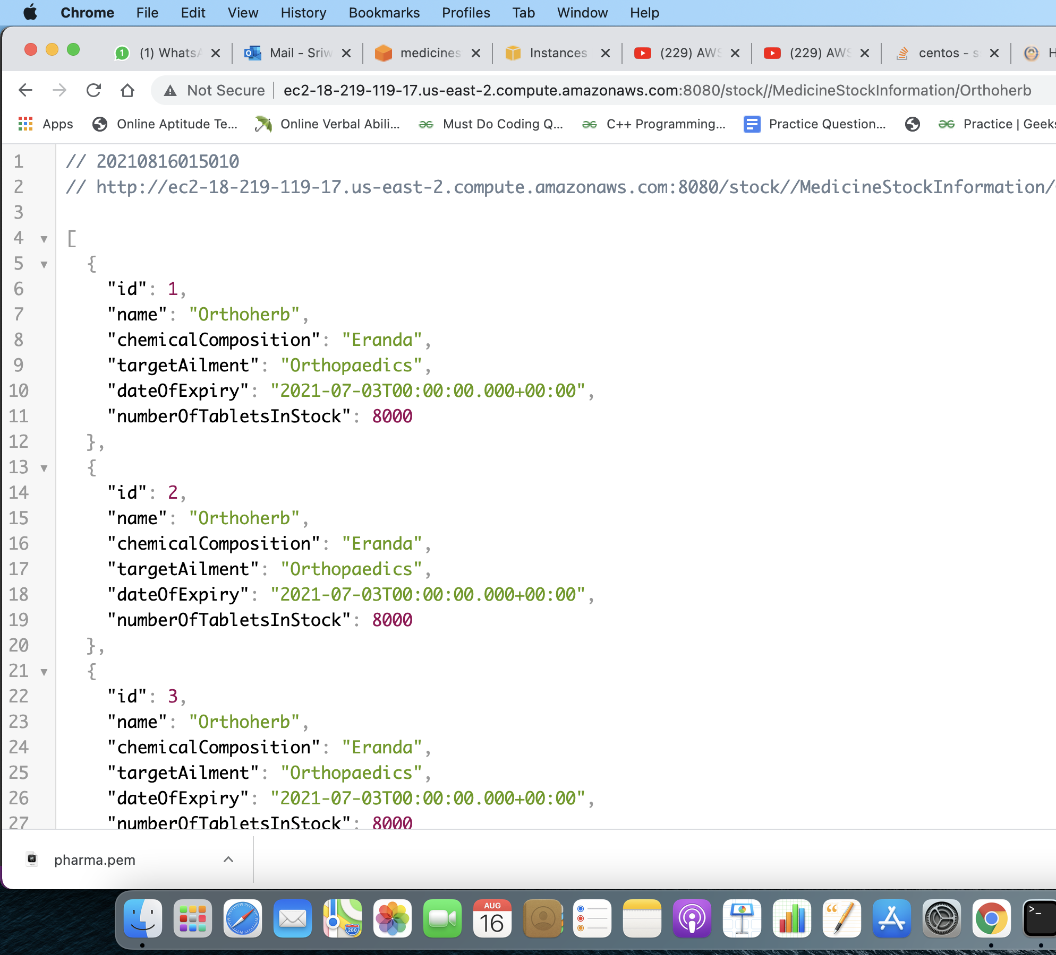
Public Ip Address: 3.138.190.159

Slide 39
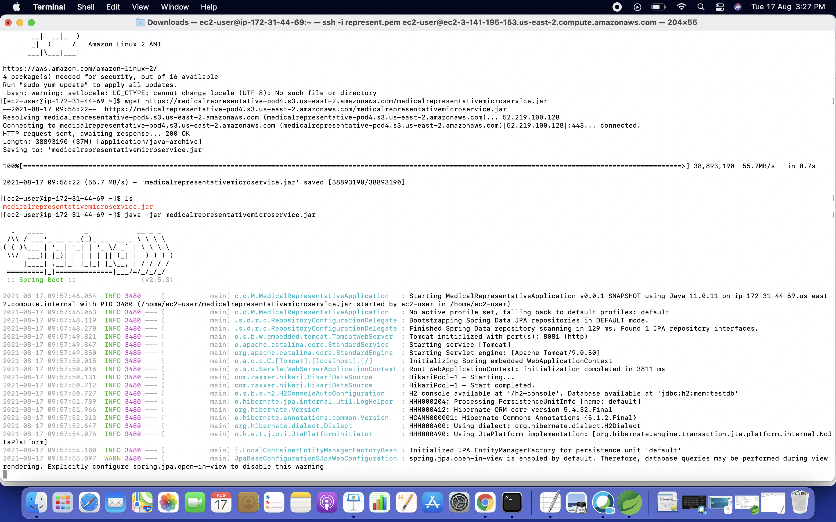
Medicine Representative Microservice Deployment

Slide 40
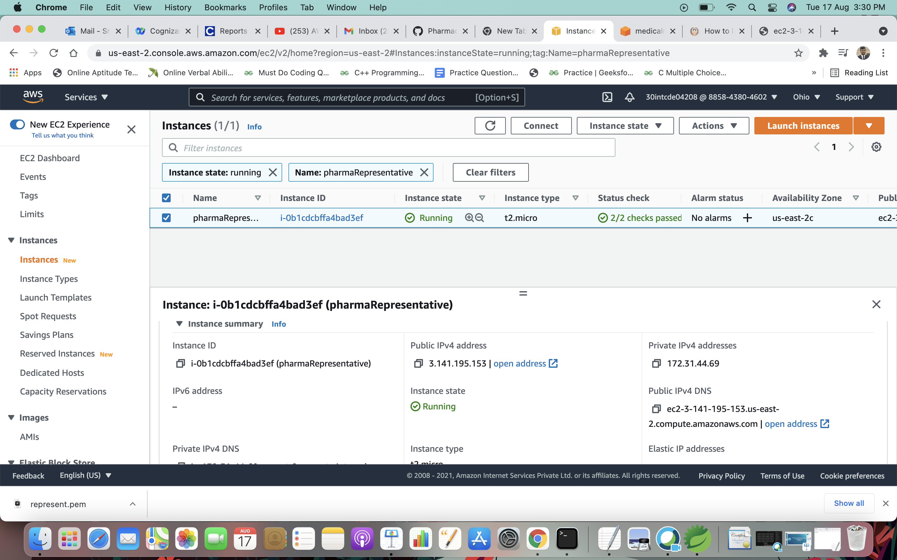

Slide 41
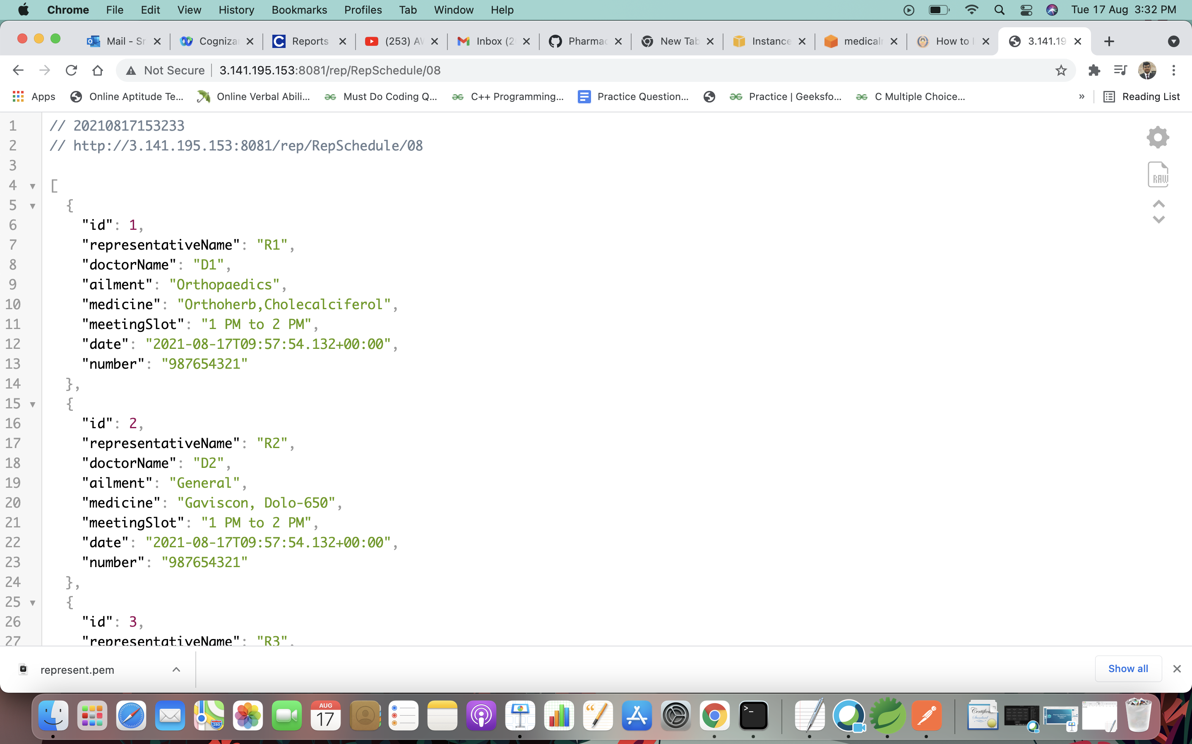
Public IP address: 3.141.195.153

Slide 42
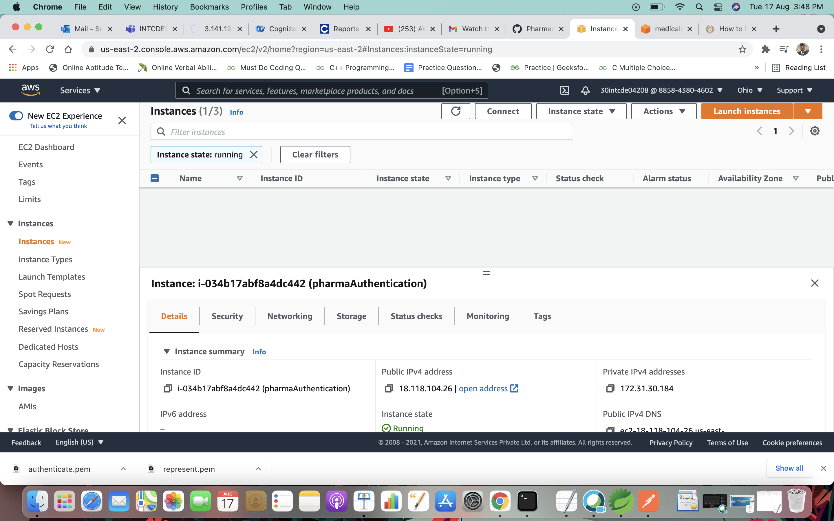
Authorization Microservice Deployment

Slide 43
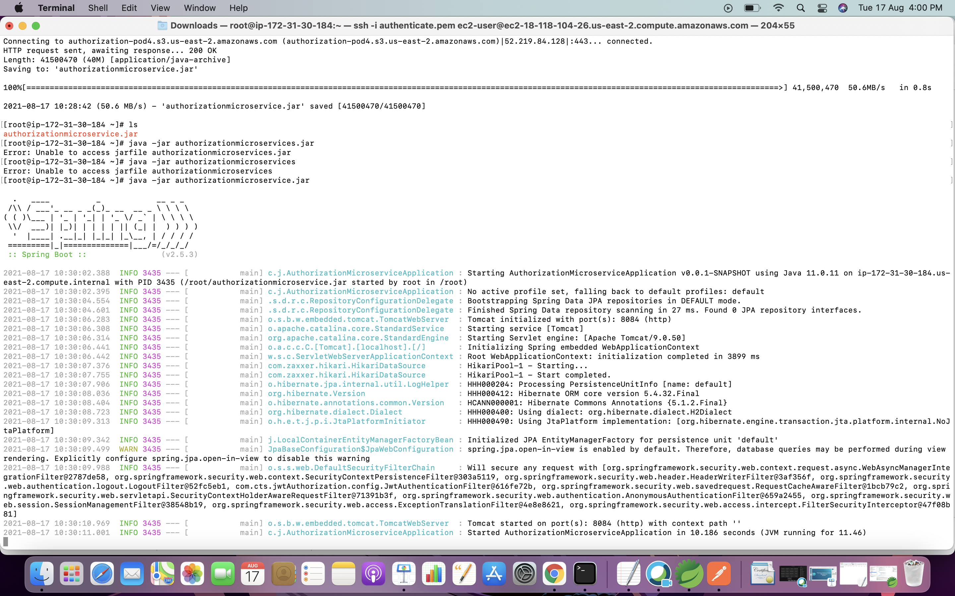
Public IP Address:18.118.104.26

Slide 44
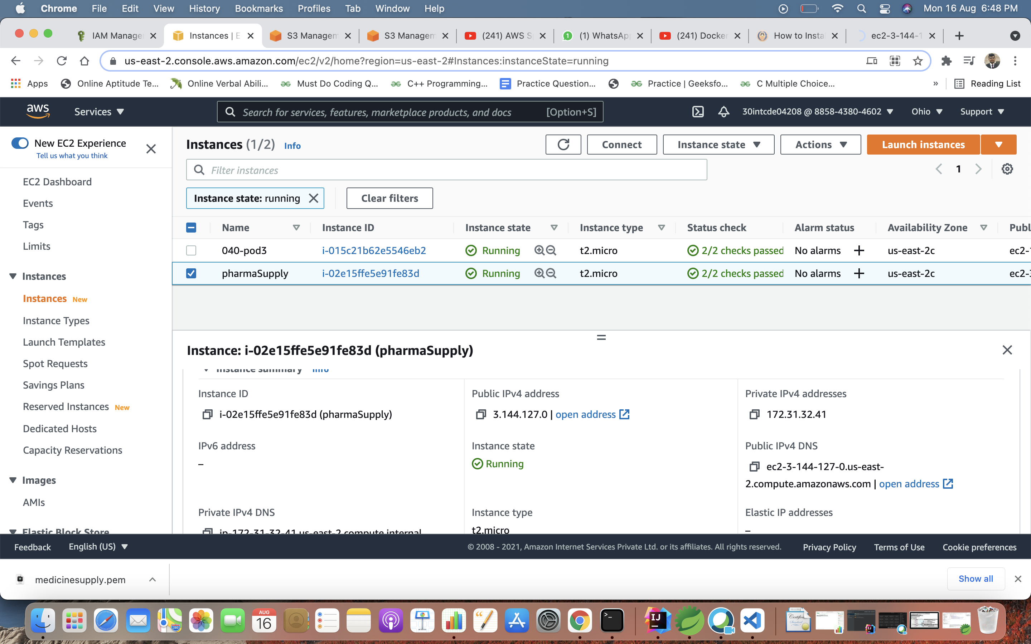
Medicine Supply Microservice Deployment

Slide 45
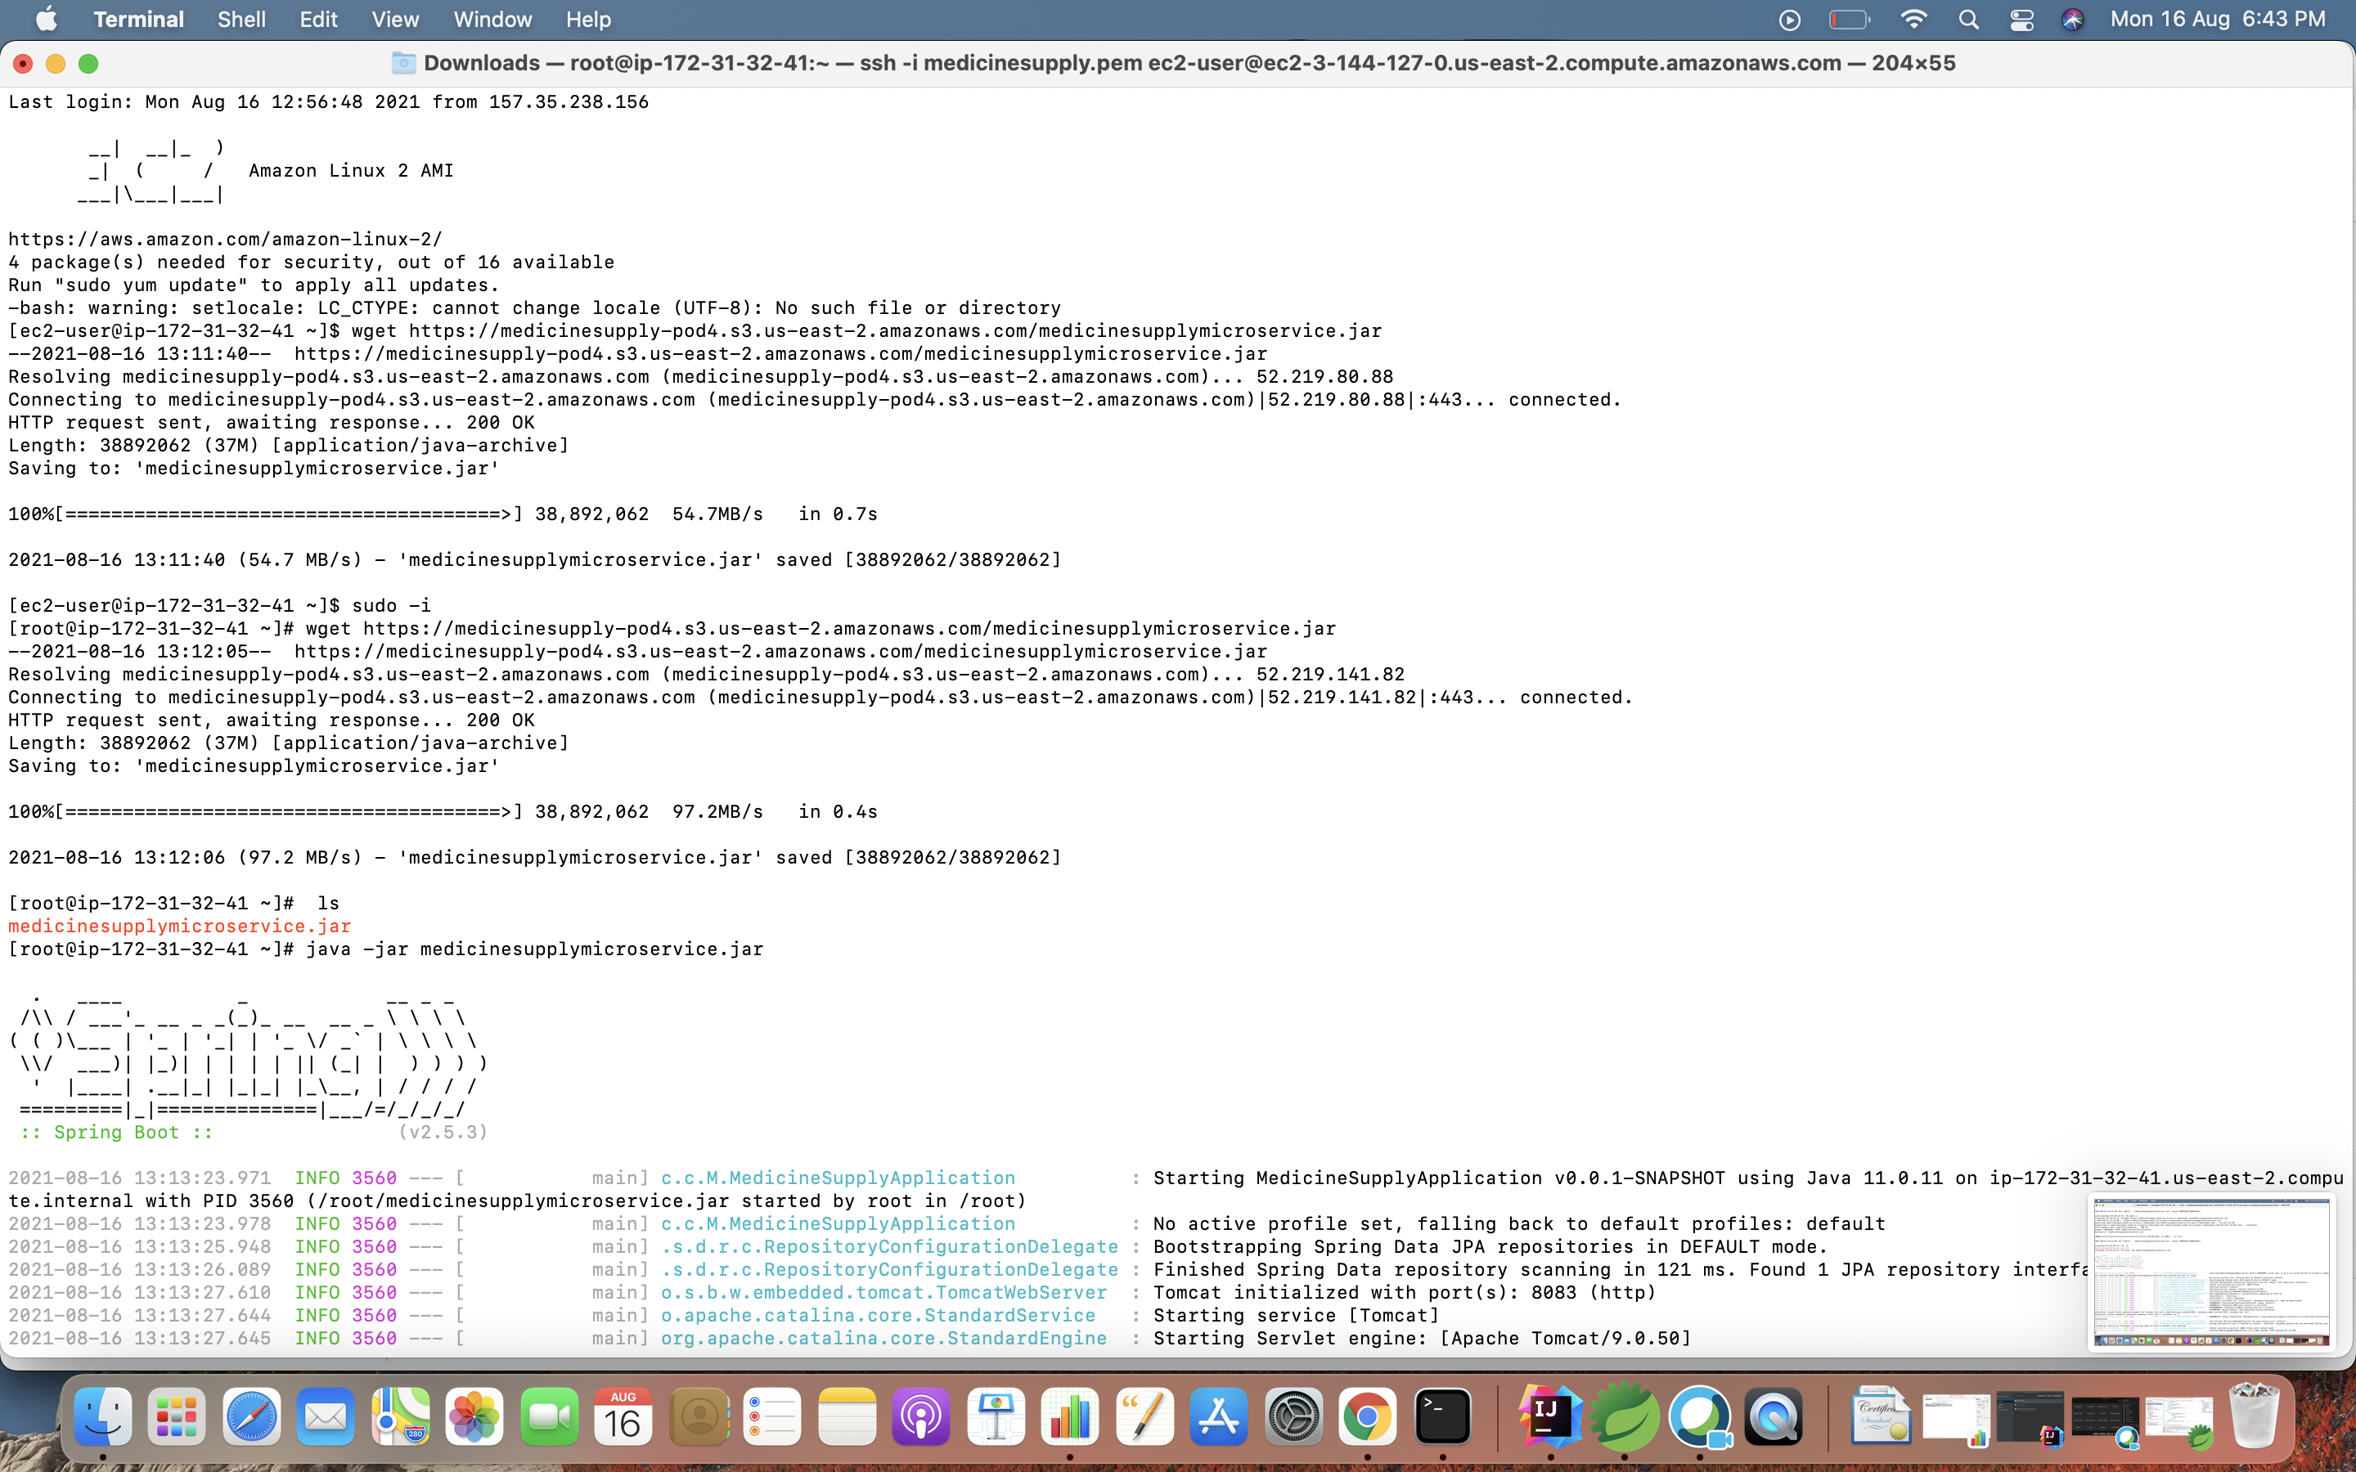

Slide 46
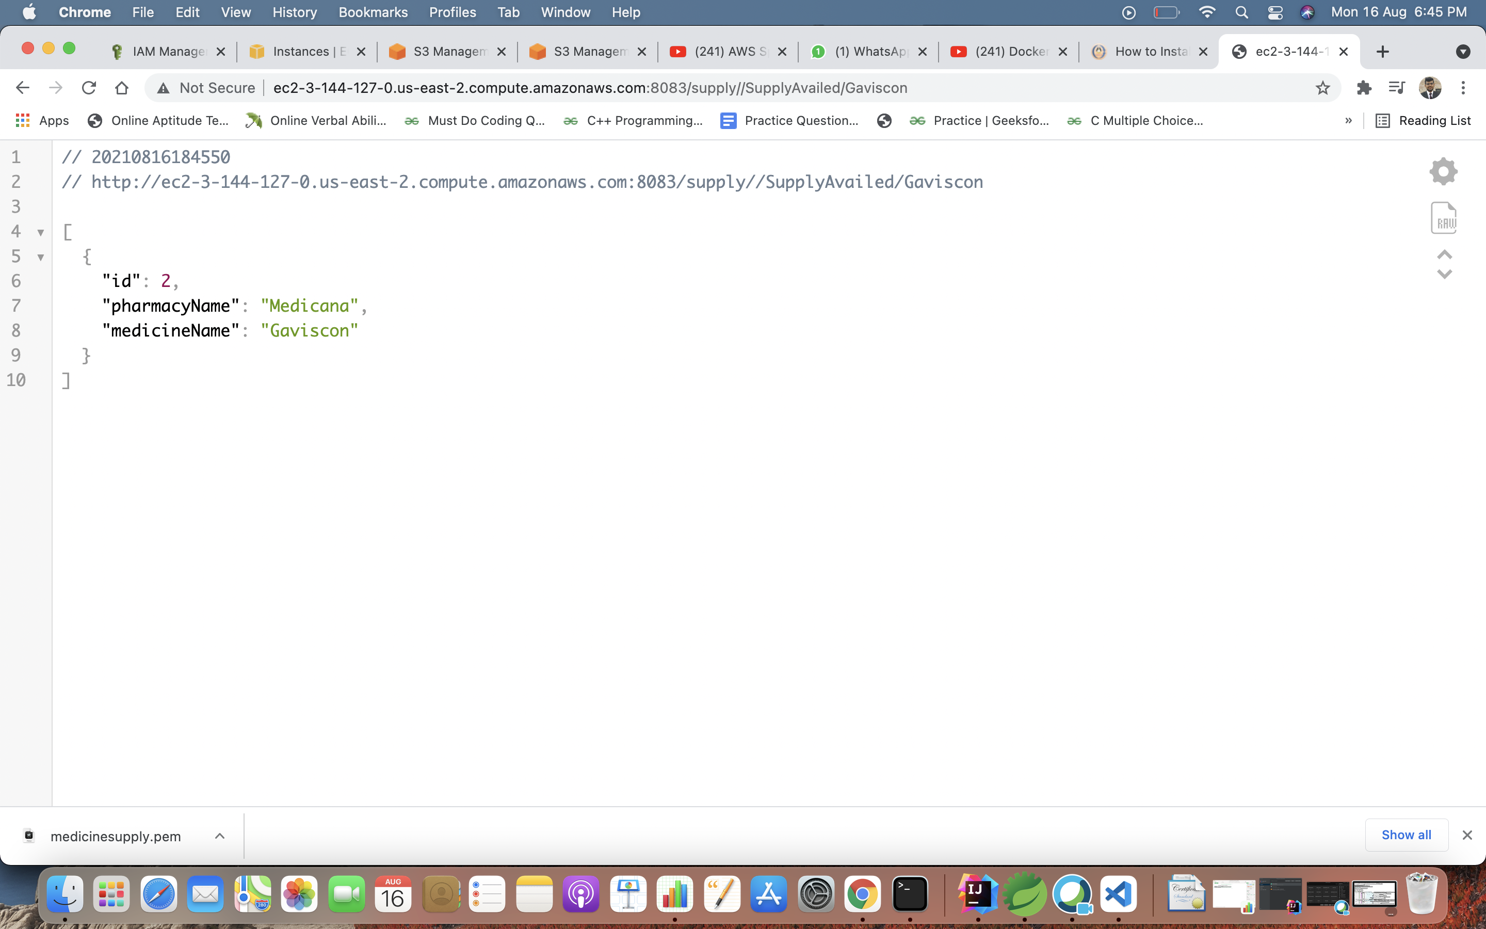
Public IP address :3.144.127.0

Slide 47

Thanks

